Slide 1



INSARAG Steering Group
Humanitarian Networks and Partnerships Weeks 2022
10 May 2022
CICG, Plénière A
Geneva
Notes:
- Make sure OCHA logo is above; be humble
- Contact Lorena
- For each session, put pics of every moderator, presenter as introduction

Slide 2
Gentle reminder for online participants:
Kindly note that your microphone is always muted.
Kindly note that you the camera is also off.
If you have any questions or comments, you can address them via the chat, which is monitored.

Slide 3
AGENDA – Part 1: Opening, Technical and Operational Updates
Session | Time | Agenda Item | Speakers
Session 1 | 09:00 – 09:45 45 minutes | Opening Statements, Presentation of the Agenda and Global Updates | Ambassador Manuel Bessler, INSARAG Global Chair Mr. Ramesh Rajasingham, Director, OCHA Coordination Division Mr. Winston Chang, INSARAG Unit Head, Global Lead Ms. Haruka Ezaki, Master of Ceremony
Session 2 | 09:45 – 10:30 10 minutes each and 15 minutes Q&A | Regional Workplans 2022 - Progress Updates | INSARAG Regional Chairs: Governor Yunus Sezer - Africa, Europe and Middle East Min. Ramón Soto - the Americas Mr. Yil Lee – Asia and the Pacific Moderator: Ms. Stefania Trassari
Tea/Coffee Break | 10:30 – 11:00
Notes:
- Who’s moderating?
-

Slide 4
AGENDA – Part 1: Opening, Technical and Operational Updates
Session | Time | Agenda Item | Speakers
Session 3 | 11:00 – 12:30 5 minutes each | Technical Working Group Workplans 2022 - Progress Updates | INSARAG Working Group Co-Chairs/Chairs Flexible Response: Mr. Paolo Vaccari, Mr. Paul Baxter Transitional Guidelines Review: Martin Evers, Mr. David Lewis IEC/R Review: Ms. Annika Coll, Mr. Dewey Perks Information Management: Mr. Peter Wolff, Mr. Jeff Maunder Light Team: Mr. Brad Commens, Mr. Rob Davis Medical: Mr. Antony Macintyre National Accreditation: Mr. Sebastian Mocarquer, Ms. Chen Hong Training: Mr. Dewey Perks Moderator: Mr. Clement Kalonga
Lunch Break | 12:30 – 14:00
Notes:
- Who’s moderating?
-

Slide 5
AGENDA – Part 2: IGM Outcomes and Issues for ISG’s Decisions and Endorsement
Session | Time | Agenda Item | Speakers
Session 4 | 14:00 – 15:15 | INSARAG Steering Group Decisions on Five Areas | Ambassador Manuel Bessler Mr. Sebastian Rhodes Stampa Mr. Winston Chang Moderator: Mr. Lucien Jaggi
Session 5 | 15:15 – 15:30 | Summary of Key Decisions and Closing Statements | Mr. Sebastian Rhodes Stampa, Chief, Emergency Response Section and INSARAG Secretary Ambassador Manuel Bessler, INSARAG Global Chair Moderator: Ms. Ana Maria Rebaza Delgado
End of the Meeting and Coffee Break | 15:30
Notes:
Still add moderators for 4&5

Slide 6
1
Opening, Technical and Operational Updates
PART 1

Slide 7
SESSION 1: Opening statements, Adoption of the Agenda and Global Updates
Notes:
1. Letter 1 of 3 from Emily must go

Slide 8
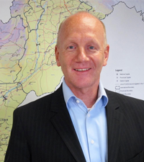

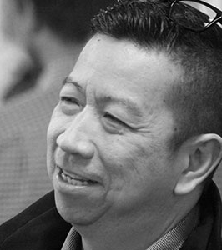
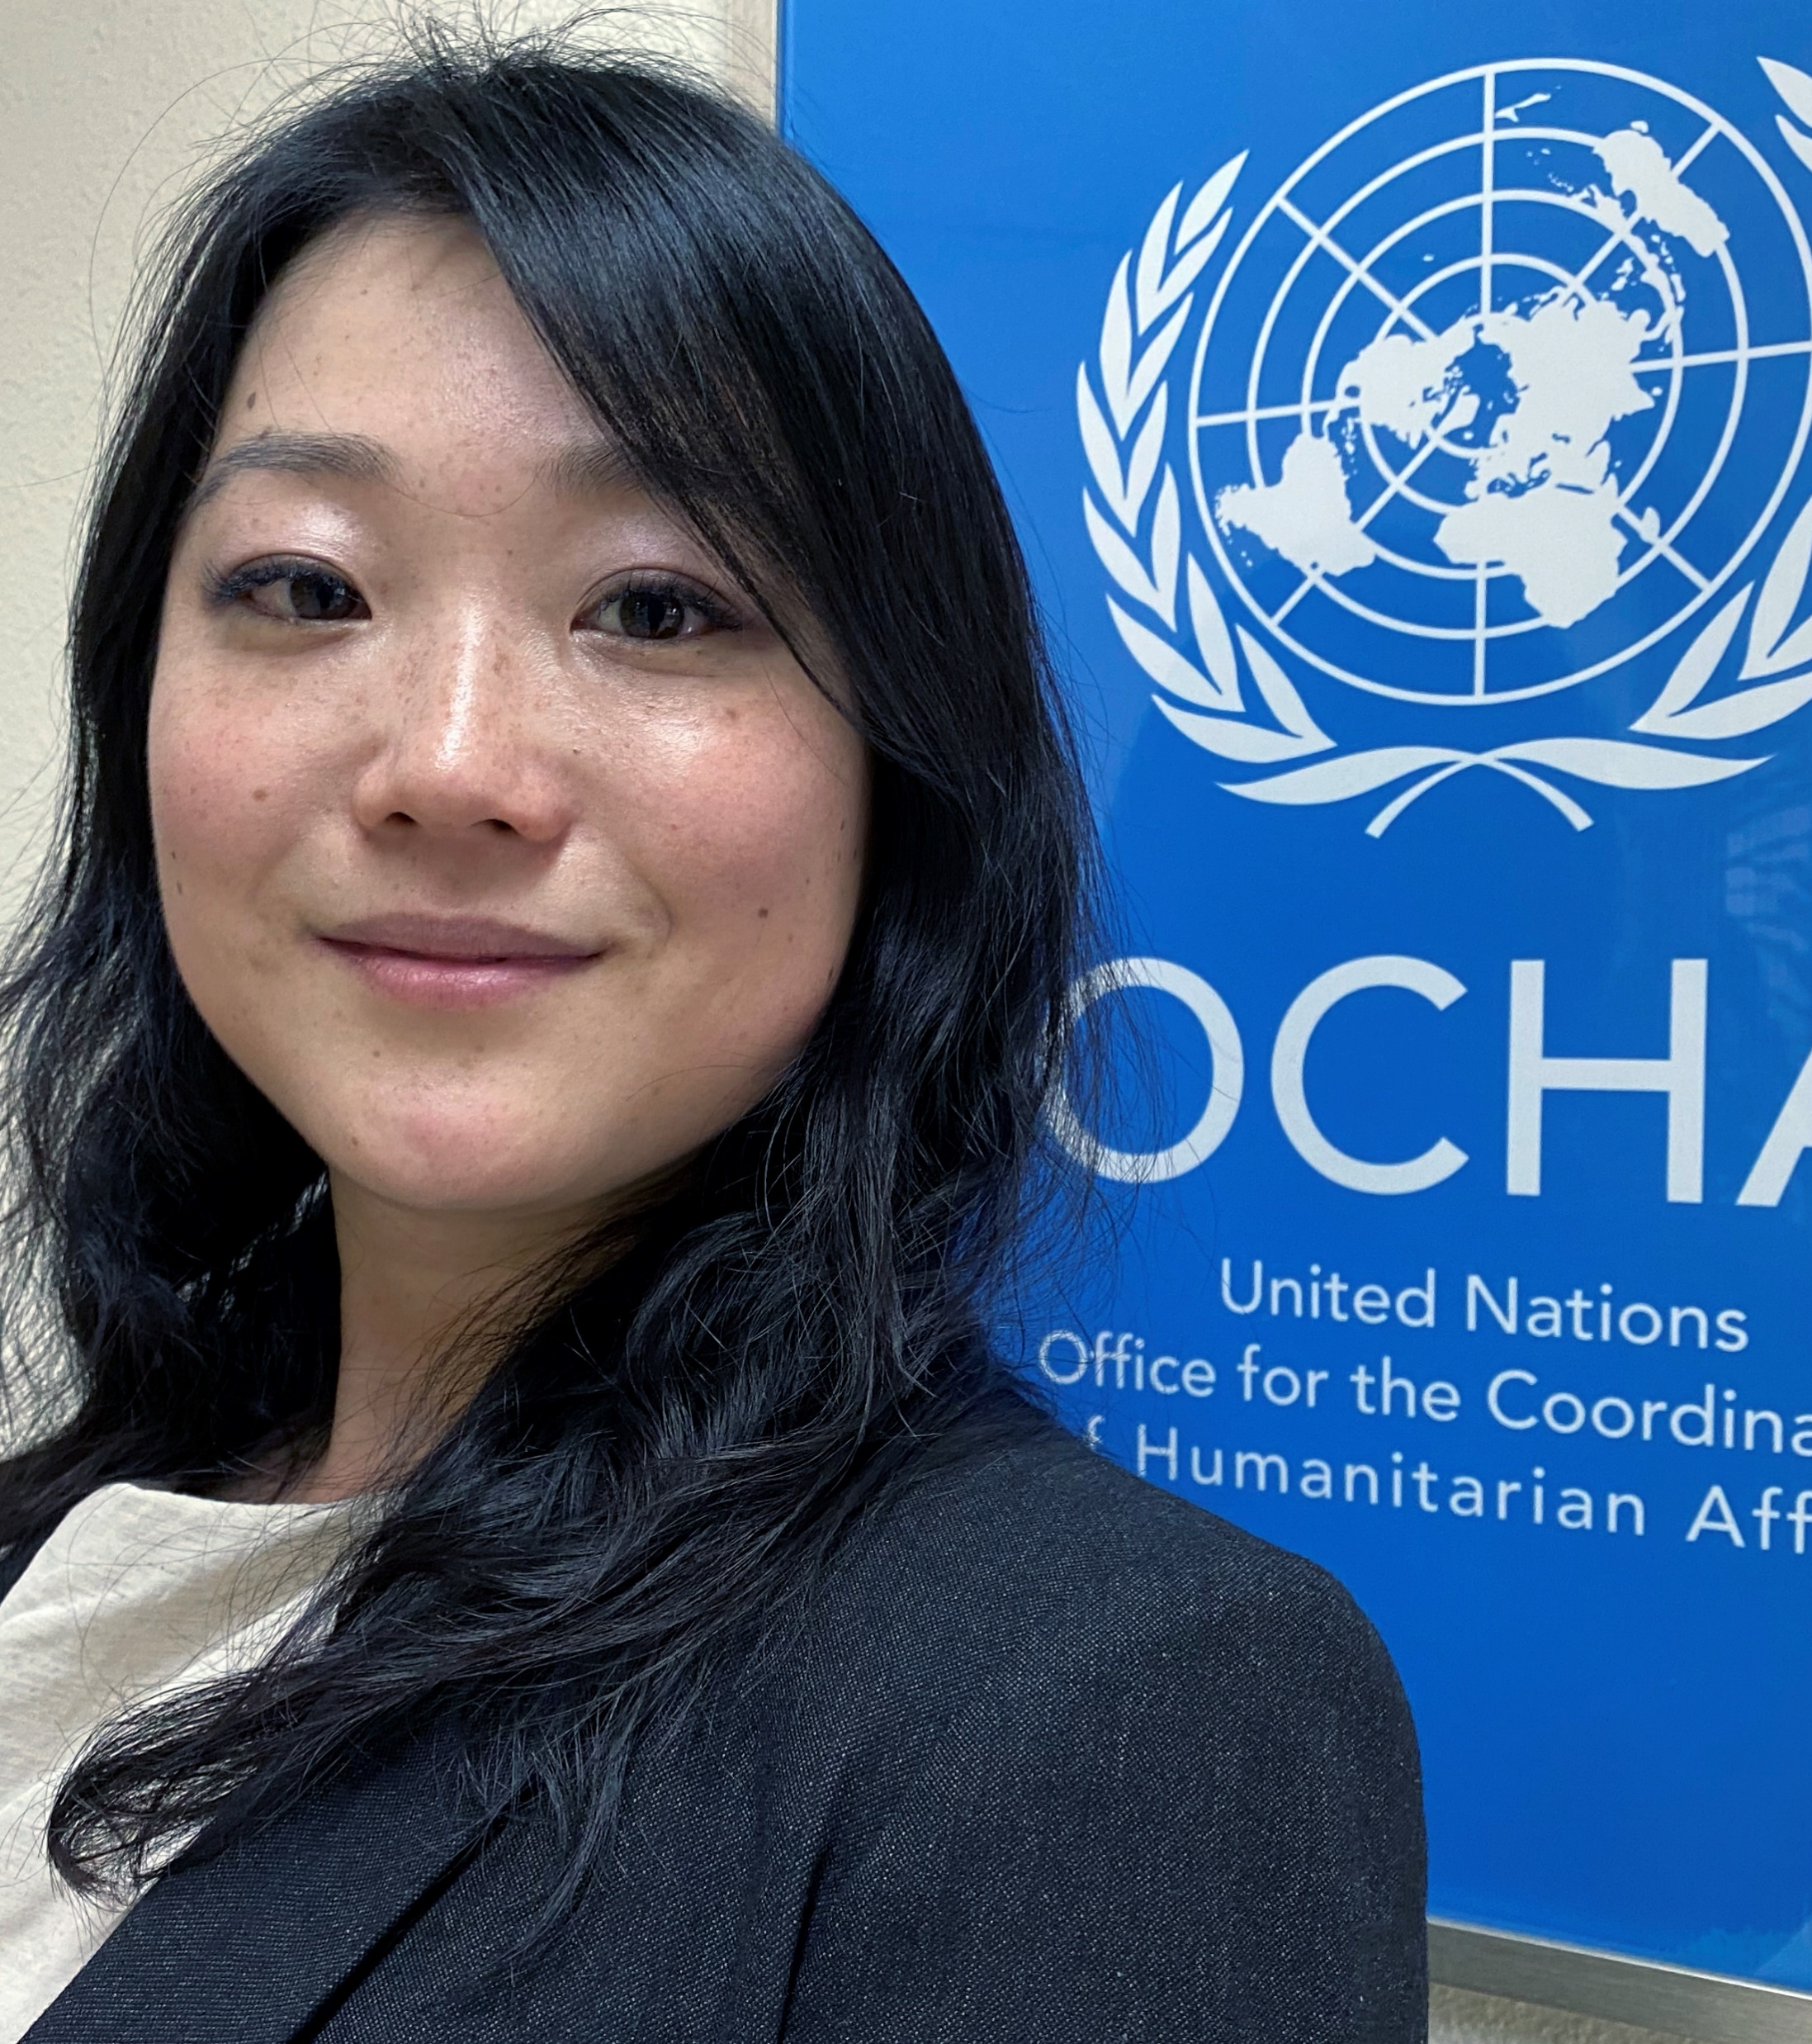
SESSION 1
Opening Statements
Ambassador Manuel Bessler
INSARAG Global Chair
Ramesh Rajasingham
Director, Coordination Division, OCHA
Winston Chang
INSARAG Unit Head, Global Lead
Haruka Ezaki
Regional Focal Point for Asia and the Pacific
Master of Ceremony
Notes:
Ramesh’s pic
Add Haruka’s pic; put a smaller size with Winston’s intro

Slide 9
SESSION 1
Global Updates
1
2
3
4
INSARAG Snapshot 2021
2022 Global Work Plan Highlights
IEC/R and IRNAP -Quality Assurance and Updates
Outcomes of Team Leaders Meeting in Doha

Slide 10
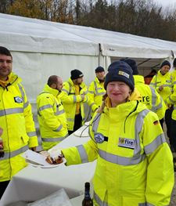
1. INSARAG Snapshot 2021
2 IECs and 2 IERs: EMERCOM Far East Russia (FER), Swiss Rescue, @fire Germany (first Light IEC), Pompiers de l’urgence internationale (PUI).
Response to the Haiti Earthquake.
INSARAG’s 30-year commemoration and third INSARAG Global Meeting
and endorsement of the Warsaw Declaration
Virtual Emergency Response Simulation Exercise (ERSIMEX) in place of the EREs.
Creation of the Flexible Response Working Group (FRWG) and its sub-working Groups – Global Position, DACC, Response to Cultural Heritage .
Joint Statement issued by the MWG and WHO EMTs on response in a pandemic.
Development of the EU MODEX IER Guide
26 virtual events, WGs meetings, AP regional webinar series, UC and ICMS trainings and EREs hosted by in Peru and China

Slide 11
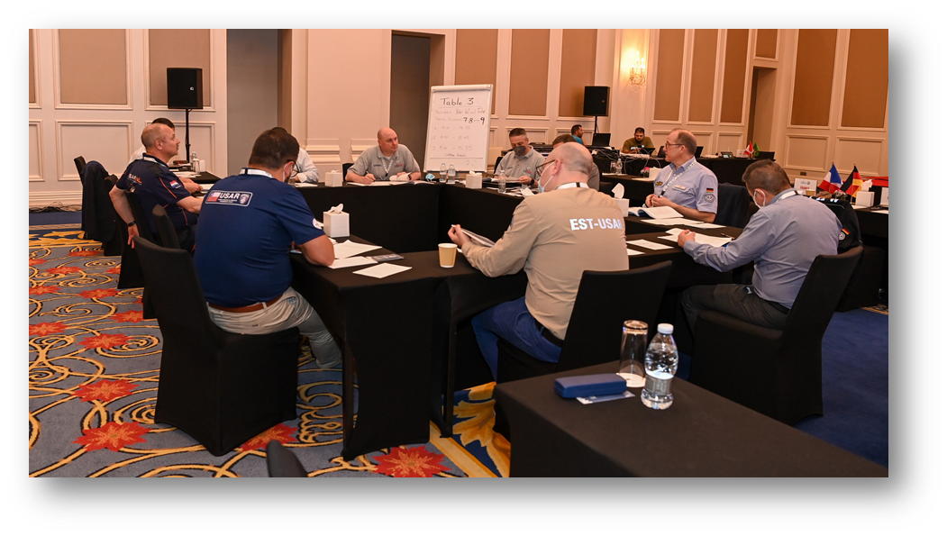
2. 2022 Global Work Plan Highlights
Three Regional Meetings:
AEME, Turkey, 13 -14 October
The Americas, Venue, Dates - TBC
AP, Republic of Korea, 11-13 October
Three Policy Meetings:​
New Year Call in Jan
HNPW- ISG in May
INSARAG End of year Call, Nov-Dec - TBC​
​

Slide 12
2. 2022 Global Work Plan Highlights
Technical Meetings and Trainings:
IEC/Rs : 5 IECs, 6 IERs (7 in the last quarter of 2022!)
(In chronological order IECs: Tunisia, Turkey (GEA), United Kingdom (SARAID), Azerbaijan, Cyprus, Saudi Arabia, IERs: United States, New Zealand, Armenia, Japan, Estonia)
EREs: Indonesia (hybrid), Turkey, Americas (hybrid – location TBC)
UC ToT (and ICMS) Training in Iceland in September
IEC/R Leadership Course in Jan 2023 in the Netherlands

Slide 13
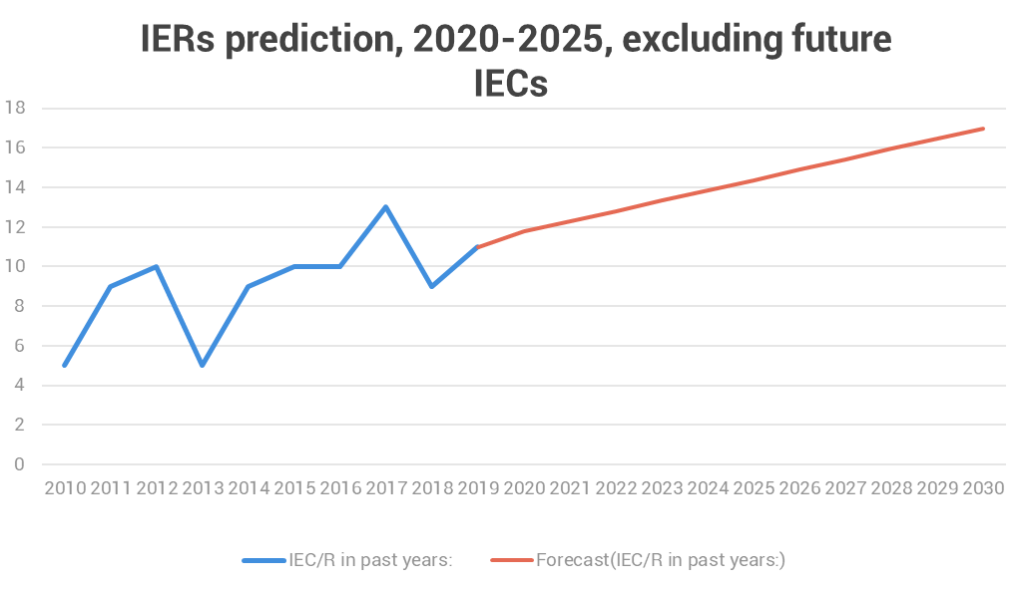
3. IEC/R Quality Assurance and Updates – Current Situation
Backlog due to the pandemic
Predictions for future years indicate a strong upward trend that will become unmanageable in 2026
Current capacity - the network’s limited resources can conduct 12 IEC/Rs per year

Slide 14
3. IEC/R Quality Assurance and Updates -
Management of IERs from 2022 onwards
Recommendations – Following the IEC/R WG Co-Chairs meeting in Geneva, April 2022:
Uphold the 2-year compulsory extension endorsed by the ISG in 2020
Prioritize backlog of IERs (20), and IECs.
TWG will organize an IEC/R Leadership Training in the Netherlands in Q1 2023.
WGs will address a revised system for IERs.

Slide 15
IRNAP - Quality Assurance and Updates
Upcoming Events:
Chile IRNAP Recognition Process – June 2022
Cyprus IRNAP – June 2022
The Americas IRNAP Course for TSR/TRG – August 2022
Singapore IRNAP – October 2022
TSG/TRG Regional Roster Status:
Asia and the Pacific – 40 applications received
Africa, Europe and Middle East
– 15 applications received
The Americas – call for application will be open soon

Slide 16


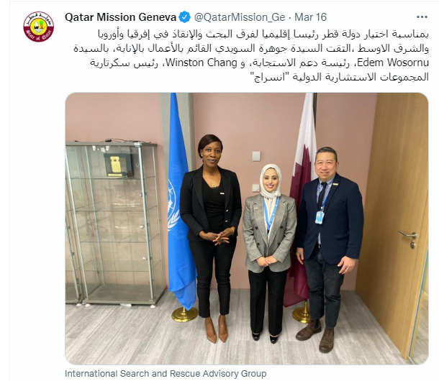
Outcomes of the Team Leaders Meeting in Doha
120 participants, 45 in person from over 20 countries and 82 connecting remotely
“We achieved more in three days face-to-face than in 30 months online” -TL Participant

Slide 17
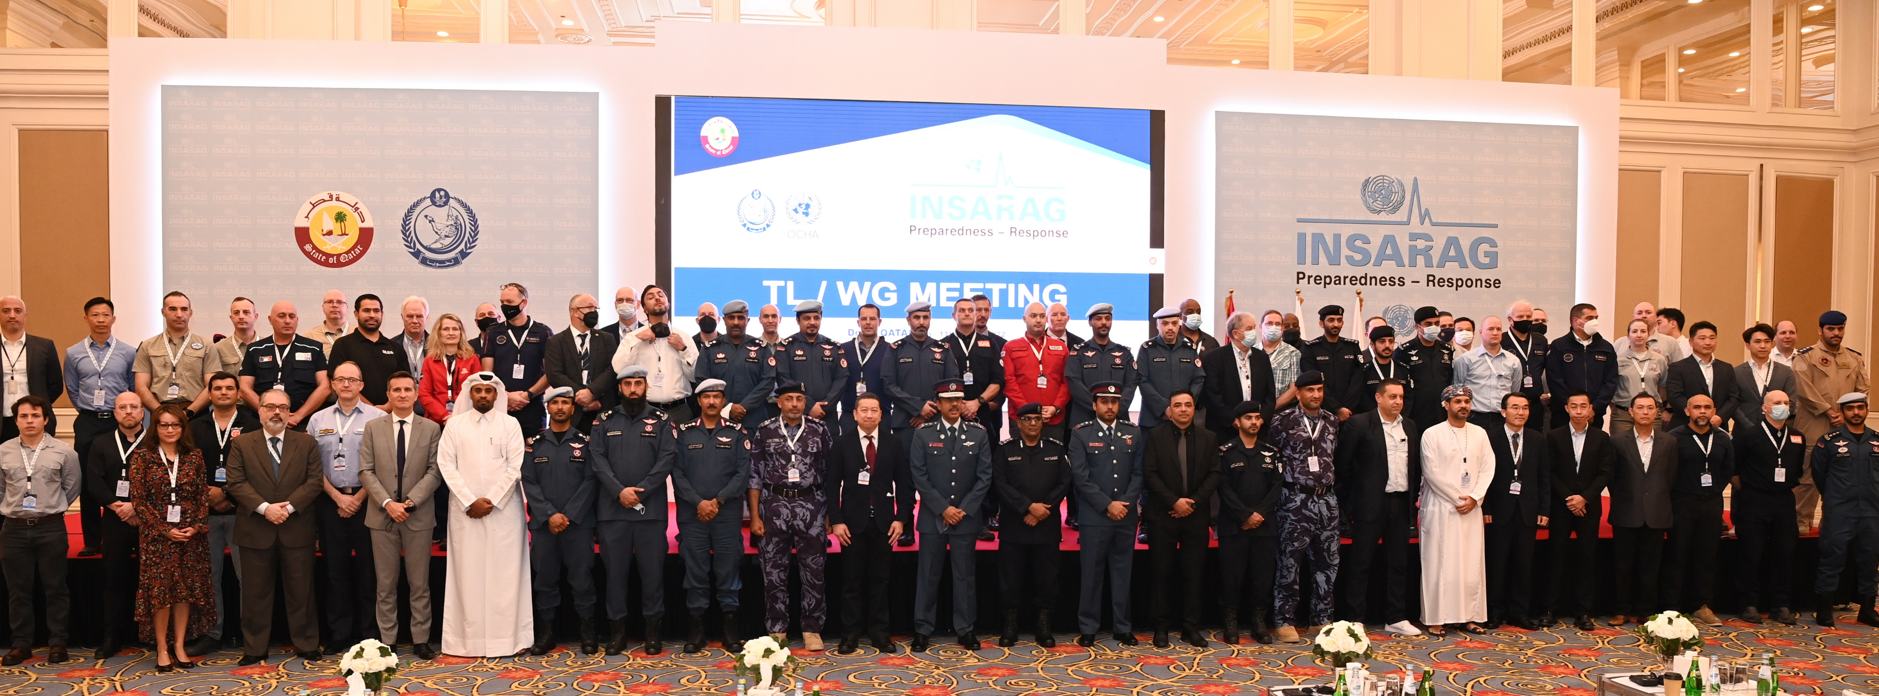
Outcomes of the Team Leaders Meeting in Doha
The INSARAG Recognized National Accreditation Process (IRNAP) Technical Guidance Note is recommended for endorsement at the ISG.
The USAR Coordination (UC) Manual V2.0 is recommended for endorsement at the ISG.
The Ongoing direction of the First Responders Program V2.0 is recommended for endorsement at the ISG.
The Light Team Quality Assurance WG will transition from a WG to a Reference Group, maintaining the same membership.
The ICMS will be supported until 2024 and incorporated into the UC Training.

Slide 18
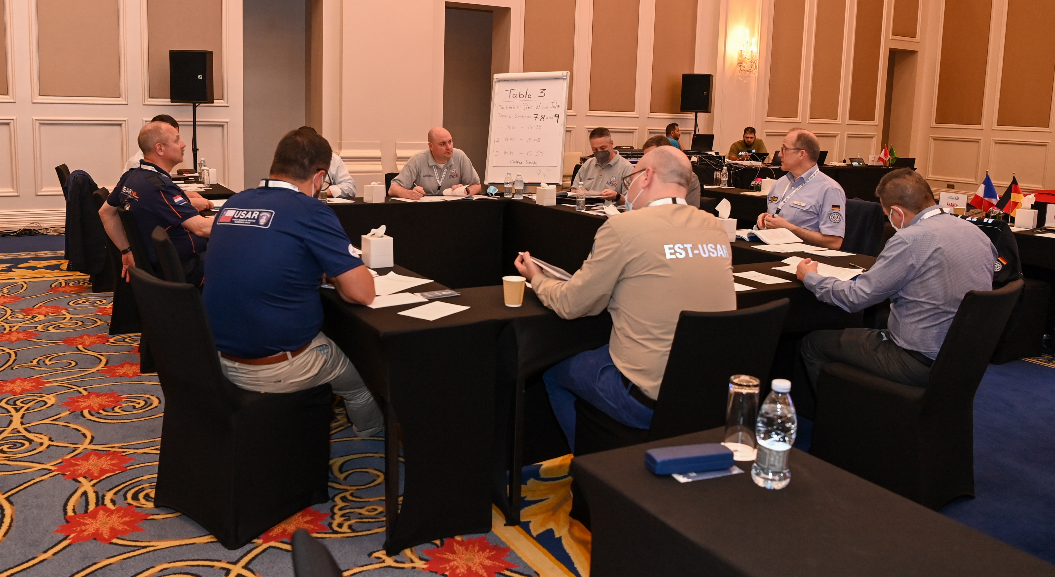
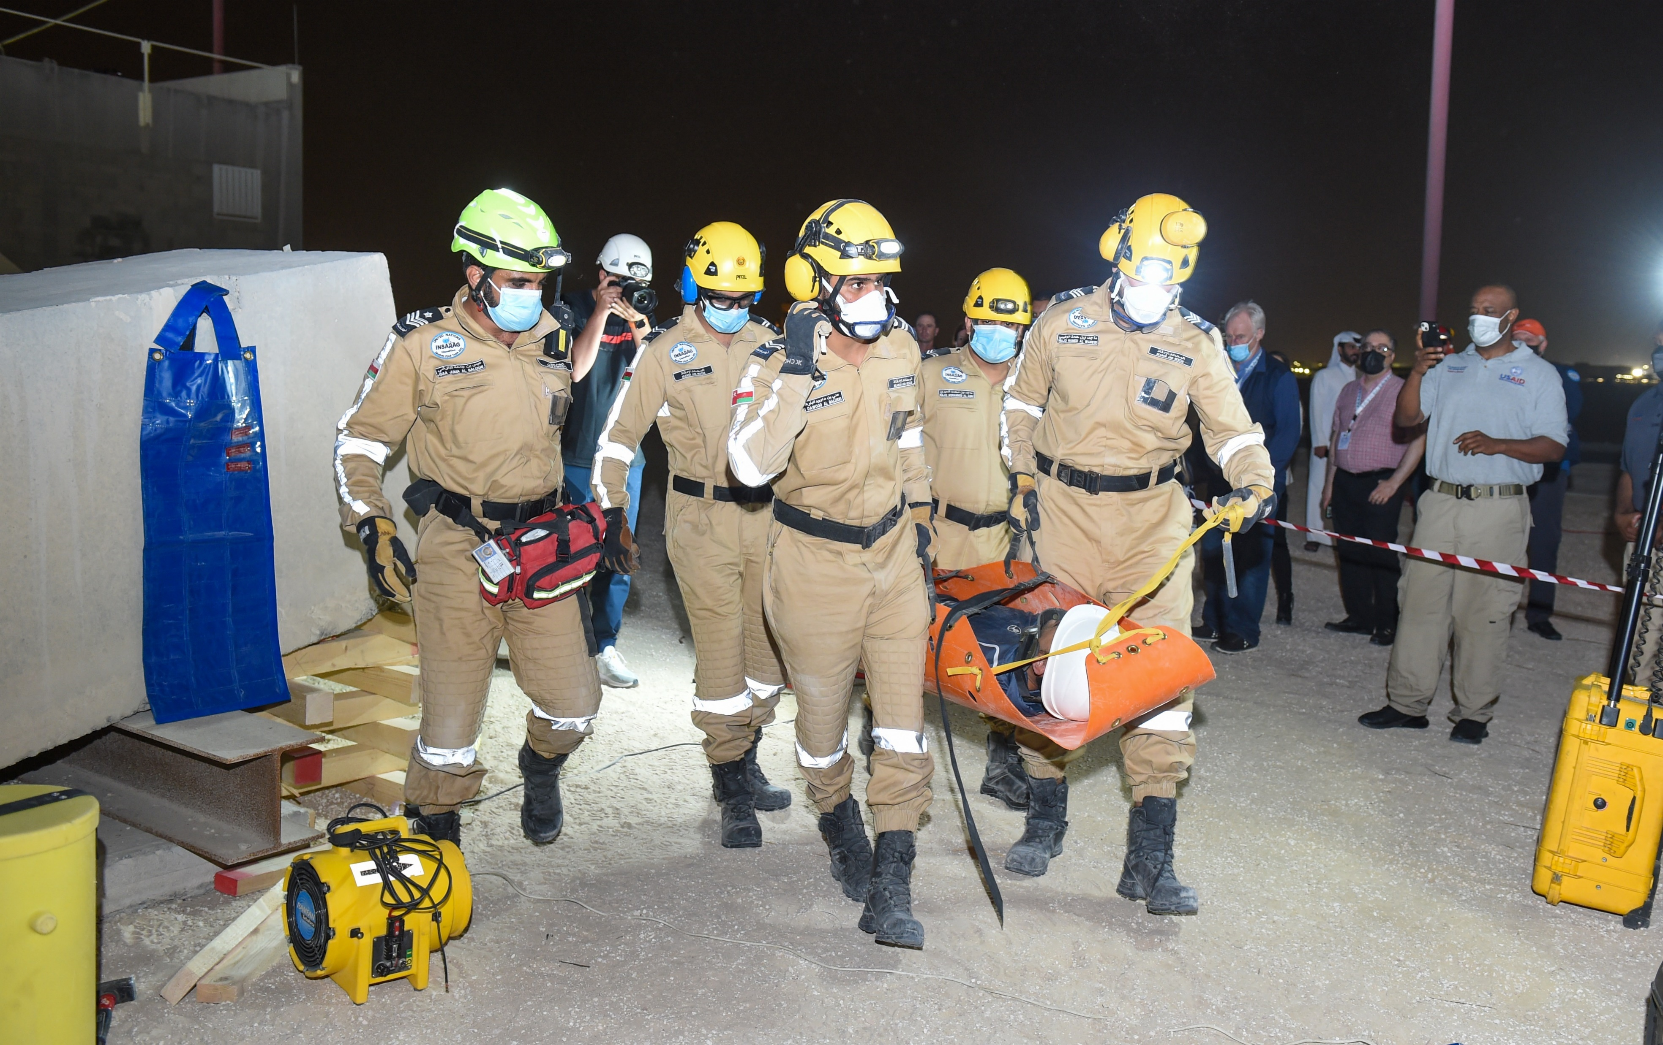
Outcomes of the Team Leaders Meeting in Doha
6. Flexible Response: The Global Position sub WG will present a progress update at the ISG.
7. The Transitional Guidelines Review Group will present a progress update on the draft Guidance Note on Bilateral Response and plans for 2023-2025.
8. The INSARAG Network will be consulted on a revised INSARAG External Reclassification (IER) system to tackle the exponential increase of IERs.

Slide 19
SESSION 2
Regional Workplans 2022
Progress Updates
2
Notes:
1. Letter 1 of 3 from Emily must go

Slide 20
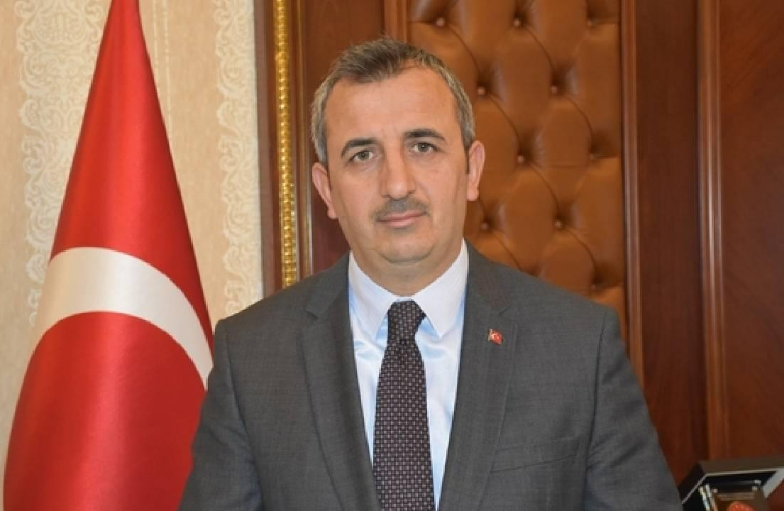
Regional Workplan 2022 – Progress Update
Africa, Europe and Middle East
Governor Yunus Sezer
Head of the Disaster and Emergency Management Authority (AFAD), Turkey. ​​
Regional Chair for the AEME Region​
Presentation by Mr. Önder Bozkurt, Deputy President of AFAD

Slide 21
Regional Workplan 2022 – Progress Update
AEME Region
Strategic Objective 1: Quality Standards
Global events:
  ISG during the HNPW, 10 May, Geneva, Switzerland
Regional events:
  AEME Earthquake Response Exercise (ERE), 10-12 October, Turkey
  Regional Meeting AEME, 13-14 October, Turkey
  AEME IECs: Azerbaijan, Cyprus, Tunisia, UK SARAID, GEA (Turkey)
  AEME IERs: Armenia, Czech Republic, Estonia, Saudi Arabia
  ICMS: further dissemination of ICMS tool, by organizing workshops
  USAR Coordination Training of Trainers, September, Iceland
INSARAG Membership:
  Egypt – IEC in 2023/24 (Mentorship)
  Turkey (IHH) - Initial discussions

Slide 22
Regional Workplan 2022 – Progress Update
AEME Region
Strategic Objective 2: Localization
First Responders Trainings, Somalia (TBC.) and Zimbabwe (Oct.).
Implementation of Africa Outreach plans for capacity building.
Strategic Objective 3: Flexible Response
South Africa SADC USAR Support Preparation and Flexible Response Partnership Support, March
USAR SA team response to KwaZulu-Natal Floods (April)
Participation in the global Flexible Response WG
Strategic Objective 4: Partnerships
Regional partnership in Africa with Rescue SA on response and capacity development (ongoing)
Strengthening of European partnership
  through the integration of IER in the EU MODEX Cycles
  European Commission and UN UCC Course, Italy, 17-22 October

Slide 23
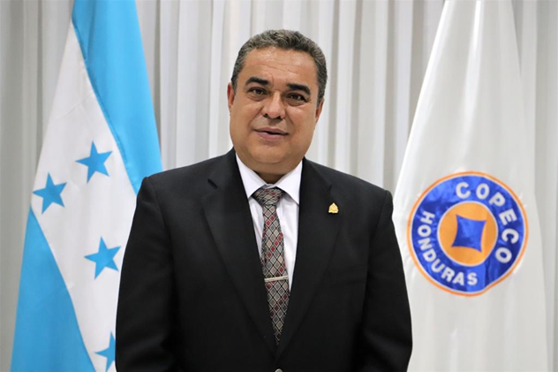
Regional Workplans 2022 - Progress Updates
The Americas region
Min. Ramón Soto
Secretary of State in ihe Offices of Risk Management and National Contingencies
Regional Chair for the Americas Region​

Slide 24
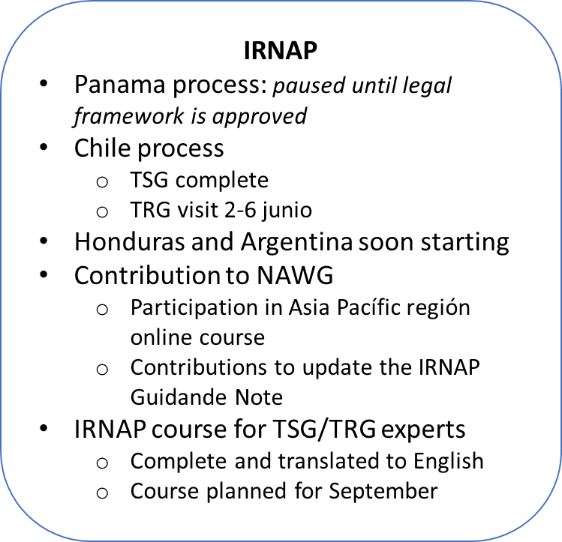
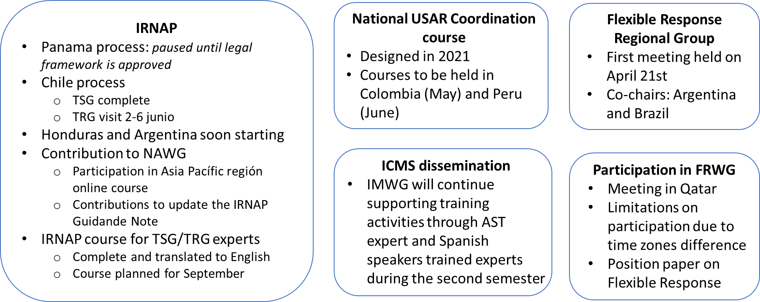
Regional Workplans 2022 - Progress Updates
The Americas region
IRNAP
Panama process: paused until legal framework is approved
Chile process
  TSG complete
  TRG visit 2-6 junio
Honduras, Argentina and Ecuador starting soon
Contribution to NAWG
  Participation in Asia Pacífic region online course
  Contributions to update the IRNAP Guidance Note
IRNAP course for TSG/TRG experts
  Complete and translated to English
  Course planned for September
IER
USA-1 team achieved its third IER in April, 2022
CHI-1 team scheduled its IER in 2024
COL-1 team scheduled its IER in 2025
National USAR Coordination course
Designed in 2021 by Americas experts
Courses to be held in Colombia (May) and Peru (June)
ICMS dissemination
IMWG will continue supporting training activities through AST expert and Spanish speakers trained facilitators during the second semester

Slide 25
Regional Workplans 2022 - Progress Updates
The Americas region
Flexible Response
Regional Group
First meeting held on April 21st
Co-chairs: Argentina and Brazil
Participation in FRWG
Meeting in Qatar
Limitations on participation due to time zones difference
Position paper on Flexible Response
Regional Humanitarian week in the Americas
Buenos Aires, Argentina
7 – 14 November, 2022
XXI INSARAG Regional Meeting & IX UNDAC Regional Consultation Meeting in the Americas (hybrid)
Earthquake Response Exercise (ERE)
IRNAP Argentina exercise
Preparation of the III Humanitarian Assistance Simulation Exercise in Central America
Event to be held on June, 2023 and preparation will start in 2022

Slide 26
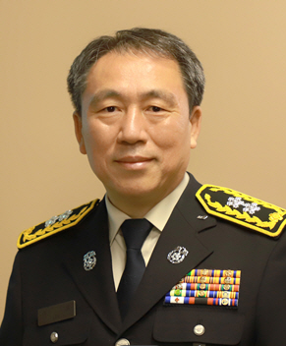
Regional Workplans 2022 - Progress Updates
Asia and the Pacific region
Mr. Yil Lee
Director General of the 119 Rescue & EMS Bureau of the Korean National Fire Agency
Regional Chair for the Asia-Pacific Region

Slide 27
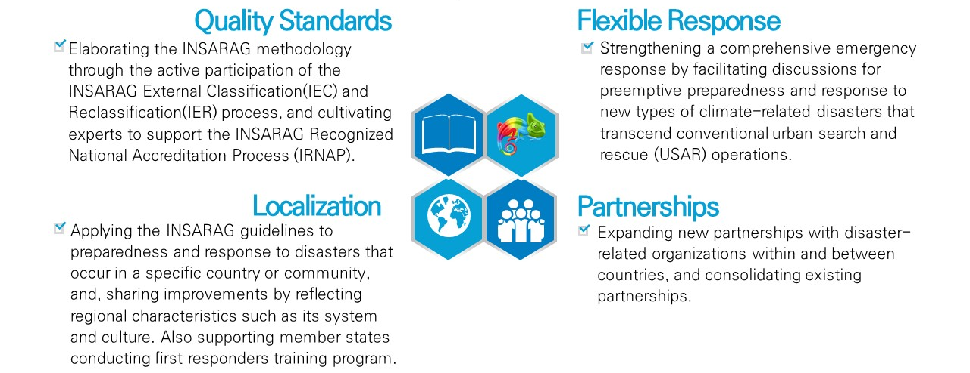
SESSION 2
Briefing on Regional Strategic Plans for 2022 – Asia & Pacific

Slide 28
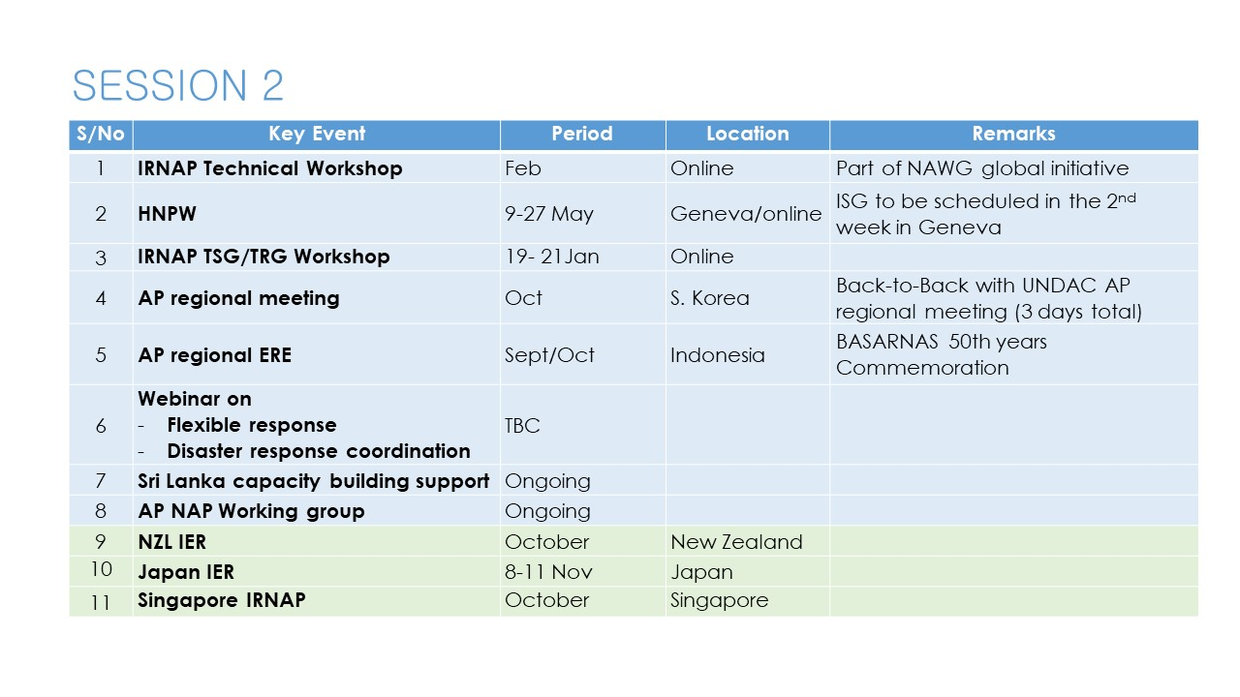
Asia and Pacific Regional Workplans 2022
The Asia & Pacific region

Slide 29

TEA/COFFEE BREAK
Meeting will resume at 11:00

Slide 30
SESSION 3: Technical Working Group Workplans 2022 - Progress Updates
3
Notes:
Letter 2 of 3 From Emily to WG co-chairs/Chairs

Slide 31
SESSION 3: Technical Working Group Workplans 2022 – PART 1
Flexible Response Working Group
Paolo Vaccari and Paul Baxter
Transitional Guidelines Review G​roup
  Martin Evers and David Lewis
IEC/R Working Group
Annika Coll and Dewey Perks
Information Management Working Group
Jeff Maunder and Peter Wolff
3
Notes:
Letter 2 of 3 From Emily to WG co-chairs/Chairs

Slide 32
Flexible Response WG

Slide 33
SESSION 3: Technical Working Group Workplans 2022 - Progress Updates
Flexible Response WG Progress Update
Paolo Vaccari and Paul Baxter – Overall Chairs
1. Global Position
2. Culture and Heritage
3. Damage Assessment Coordination Centre

Slide 34
TABLE OF CONTENT
1
2
3
Global Position
Co-Chairs
Thomas Zeiter and Otty Rusinarsetyo
Culture and Heritage
Co-Chairs
Aparna Tandon and Jing Wang
Damage Assessment
Co-Chairs
Solveig Thorvaldsdottir and Joshua Macabuag
(Now replaced by Mark Scorer)

Slide 35
1
Co-Chairs - Thomas Zeiter and Otty Rusinarsetyo
Global Position

Slide 36
Global Position
Principles Established – Strong support for progressing through members surveyed
Defining What Flexible Response Means
  Beyond the Rubble (BtR)
  Flexible Response (Flex-R)
Current “Modular Capacities” able to be deployed on a FlexR
  Management
  Search
  Rescue
  Medical
  Logistics
Additional Capacities that may exist within USAR teams already
  Wildfire
  Water/Flood Rescue
  CBRN, etc
Principles of self-sufficiency remain
Minimum Standards required
Current Capacities through USAR classification process
Additional Capacities, yet to be determined

Slide 37
Implementation
Current Thinking
Endorsement from ISG when concept finalised
Stage One – Registration of Modular Capabilities (VOSOCC)
  Each team opts in or out by registering the modular capacities they are prepared to deploy on a FlexR basis
  Interim additional capacities registration. Each team opts in or out by registering additional capacities they are prepared to deploy on a FlexR basis. This is to assist INSARAG Secretariat manage requests until additional capacities under INSARAG banner are formalised.
Stage Two - Additional capacities INSARAG identifies and agrees to adopt are prioritised for further formal development (standards, guidelines, etc)

Slide 38
Issues still for resolving
Working Group Tasks
Working through EU issues of coordination and overlap
Any integration actions required for Damage Assessment and Cultural Heritage Flexible Response Working Groups
Further development of Description of Individual Capacities in Concept Paper
Global mapping exercise of additional capacities within teams (e.g., DACC, flood, water purification, etc)
Determination of prioritisation list for additional capacities if endorsed by INSARAG
  Identifying any existing standards/guidelines in existence for adoption/adaption
  Definition of the process of verification of respect of standard for the new capacities

Slide 39
2
Co-Chairs Aparna Tandon and Jing Wang
Culture and Heritage

Slide 40
Cultural Heritage
Progress Update (1)
  The Sub—FRWG response to the Cultural Heritage has summarized over 80 items of feedback from different organizations and workgroups (e.g., FRWG/SWG-Cultural heritage/The DACC Working Group/DR tea, Ministry of Foreign Affairs of Japan/ Queensland Fire and Emergency Services of Australia etc.)to the existing Guideline of the Cultural Heritage and integrated a primary recommendation on the Manual.
  The basic principle of the existing cultural heritage draft Guideline is endorsed by the group.
  And the structural modification to the Guideline under the INSARAG Guide is the next step.
  An updated version of the Guideline will be available by June 2022

Slide 41
Working progress on the feedback of the draft Guideline
Urban Search And Rescue At Heritage Sites - A Guide For The Field
Main Feedbacks and Recommendations：
The Working Group endorses the direct and important social benefits that come from protecting cultural heritage during USAR operations.
The current draft (by UNESCO) of a field guide for USAR operations at heritage sites should be further developed and modified as per the feedback mainly for scenario 1 where USAR act under their full responsibility.
Scenario 1: Search and rescue at a heritage site
Scenario 2: Beyond the rubble stage assistance
Scenario 3: Flexible response assistance is sought for cultural heritage rescue

Slide 42
Working progress on the feedback of the draft Guideline
Urban Search And Rescue At Heritage Sites - A Guide For The Field
Main Feedbacks and Recommendations：
Create a paragraph(s) that is relevant to engineers in the context of cultural heritage. INSARAG documents usually do not list authors.
Extract the information that is new for USAR teams in the context of cultural heritage.
Optimize the use of OSOCC or VOSOCC, integrating the information of cultural heritage.
When working on heritage sites Beyond the Rubble, at the request of LEMA and jointly in close collaboration with relevant national cultural heritage agencies.

Slide 43
3
Co-Chairs:
Solveig Thorvaldsdottir and Joshua Macabuag
(now replaced by Mark Scorer)
Damage Assessment

Slide 44
Damage Assessment Coordination Centre
Progress Update (1)
Change in Co-Chair from Josh Macabuag to Mark Scorer
Currently working as two groups at the moment:
  Engineering group
  Coordination group
The WG has met 14 times since September, either as a whole or in one of the groups.
Discussions on the format of the DACC Handbook have suggested that the format of the new UC manual is a good candidate for a format for the DACC handbook. The UC manual provides a good overview of various activities that form a basis of discussion for the DACC.

Slide 45
Damage Assessment Coordination Centre
Progress Updates (2)
Coordination Group is focussing on: -
  previous events and literature
  coordination details for aquiring USAR team engineers to participate in the engineering damage assessment for the DACC
  DACC staff and resources
    The annexes in the UC manual will be used a template for outlining staff requirements, etc.
  coordination of engineers to be most effective in assisting national engineers
  understanding the important role of UNDAC/OSOCC in the context of setting up the DACC with the local municipalities.
  outlining the role of the UCC in the damage assessment coordination
  DACC support coordination with clusters
    Shelter
    Early recovery
  creating a timeline for Engineer/DACC activities

Slide 46
Damage Assessment Coordination Centre
Progress Update (3)
Engineers Group is focusing on
  Coordination with national entities and procedures
  Procedure for Technical On-Site Assesment of Damage
  Some key decisions:
    DACC guidance should be generic (not specific to earthquake, but applicable across flood, hurricane, blast, etc).
    Any output should be as concise as possible, with minimal text (figure/diagrams preferred), and referring to existing docs where possible.
Still on track to complete project for HPNW !

Slide 47
2. Transitional Guidelines Review WG

Slide 48
SESSION 3
INSARAG Working Group Updates - Transitional Guidelines Review WG Progress Update
Transitional Guidelines Review Group
David Lewis co-chair AUS
Martin Evers co-chair NED
Anthony Toh SIN
Patricio Fuentes CHI
Belit Tasdemir TUR
Ove Syslak NOR
Secretariat SCDF SIN
INSARAG Secretariat

Slide 49
SESSION 3
INSARAG Working Group Updates - Transitional Guidelines Review WG Progress Update
Terms of Reference (ISG endorsed)
Support and advice stakeholders
Encourage implementation, translation
Report and update governing bodies (TLM, RM’s, ISG)
Clarify, support and moderate
Identify issues for upcoming cycle and Guidance Notes
Transition to GRG in 2023
Modernize the appearance and administration
Work alongside the WG’s
Keep updated adminstration

Slide 50
SESSION 3
INSARAG Working Group Updates - Transitional Guidelines Review WG Progress Update
GL’s, GN’s, TRL
Item Binding Updated Governance
Guidelines YES 5 yearly ISG
Guidance Notes YES 1 yearly ISG
Technical References NO Continuously WG’s

Slide 51
SESSION 3
INSARAG Working Group Updates - Transitional Guidelines Review WG Progress Update
Responsibilities
WG’s responsible for the content of their work
T-GRG only to safeguard:
    Consistency
    Terminology
    Guideline, Guidance Note or Technical Reference
    Proper administration
Bilateral Response Guidance Note

Slide 52
SESSION 3
INSARAG Working Group Updates Transitional Guidelines Review WG Progress Update
Practical approach
All Working Groups are assigned a Point of Contact from T-GRG
T-GRG meets in plenum 2 times a year (TLM and ISG)
T-GRG to gather feedback from teams
GRG will consist of 3 representatives per INSARAG region
2023 T-GRG will develop to GRG
2025 GM new Guidelines to be endorsed and published
Q4 2024 all content (from TLM and WG’s) should be ready for processing

Slide 53
SESSION 3
INSARAG Working Group Updates
Transitional Guidelines Review Group
Thanks for your attention!
Open for questions

Slide 54
3. IEC/R WG

Slide 55
PPT OVERVIEW
Achievements of the IEC/R Review WG since creation
Proposals for revised IEC/R system
Revised IEC/R Review WG Terms of References

Slide 56
Achievements
IEC/R System Review WG Workplan
Reviewed regional expert roster
Revised guidance for nominating Classifiers (for Policy, Operational, and TL Focal Points)
Review of the Global IEC/R Review Report recommendations

Slide 57
IEC/R Review Report: Areas of Improvement Current Status
Collecting and disseminating best practices within the IEC/R process Including a tab on the webpage for “best practices” based on topic and includes from which USAR Team / IEC report has an additional doc. that cites best practices.
Ensure quality of Classifiers and of the process. ToR
Sustainability of the Classification system based on rising numbers (dealing with the revised IER system)
01
04
07
Training for TLs, mentors, and INSARAG Secretariat /Conduct awareness sessions in the margins of all meetings and activities for quality assurance systems (specifically targeting all three FPs –policy, operational and TL)
Develop a separate IER Checklist
02
05
Enhancing the preparation of Classifiers by the FPs & TL using Manual C prior to IEC/R (see point 01)
08
Guidance in INSARAG documents as they relate to:
Pre-validation, exercise organizers, updating the report template with best practices, and inclusion of a code of conduct for the Classification team. (Mentor’s job and their ToR needs to be revised)
03
Color codes on the IEC/R Checklist Strong consideration to remove color coding during the review.
06
09
Reinforce DEI awareness
Notes:
(3) So much attention to color coding rather than spending time on the Advisory Note. There is now linkages to the color coding with the IRNAP. Possibly removing the yellow from the color-coding process/ having green be the color to identify “best practices”
(4) Has been talked about since 2004, coming from the advisory note that highlights best practices.
(9) DEI possibility to equating to a “best practice”

Slide 58
Proposals for IEC/R System
PROPOSALS FOR ENSURING QUALITY IN THE IEC/R PROCESS
Increasing the responsibilities of the Mentor
  Creation of a Handbook (streamline Vol. 2 Manual C)- Including guidance on pre-validation
  Broadening the membership role in the community (ex. Joint mentorships)- idea from EMT
Conduct awareness sessions in the margins of meetings (ie regional) for quality assurance systems (specifically targeting all three FPs –policy, operational and TL)man b Proposal to be accepted by ISG
T/GRG bringing Vol. 1 up-to-date (Ensure the current Code of Ethics covers all INSARAG activities)
Revise and update the Minimum standards found in Manual A and Clarify-checklist accordingly
Include a tab on the webpage for “best practices” based on topic and include from which USAR Team it comes. Could be clarified further accompanying it with graphic material if needed (to provide by team/classifiers)
Ensure Classifiers are being trained at the local (national/regional/local/Team) level (to be included in ToR to become a classifier-objective of the WG to update this and propose. Keep in training Classifiers, that could receive evaluation report from TL)
Leadership Course for TLs, mentors, and INSARAG Secretariat representatives. KEY COURSE
Notes:
Emphasis what you must do, not how. (finish in a certain amount of time)

Slide 59
Proposed Options for Revised IER System
There is concern of a lack of classifiers for the number of IERs that will soon need to be scheduled. We need to do an analysis of where we are to plan efficiently for the future. If the gap as example is with Secretariat Representatives, we need to work to increase that pool.
Consider joint IERs
Strengthening the portfolio of evidence (POE) submissions and place more responsibility on the role of the Mentor to pre-validate (not pre-green) creating less work for the classifying team.
Annual self-evaluation of field exercises/and how continuation of learning has been accomplished during the pandemic.
Open discussions on creation of a separate checklist for re-classifications to measure how best to increase the minimum standard and improve quality in the network.

Slide 60
Proposed Options for Revised IER System
Discuss the possibility Full Classification every 10 years / Re-classification every 5 years. Other option every 7-8 years. Secretariat is willing to manage a lot of IERs
Explore new options for Re-classification during upcoming IERs
Suggest an annual meeting with that years IEC/R Team Leaders to discuss how the checklist worked, and their ideas for improvement for the future
Create a virtual system to also collect the Team’s comments to capture their impressions of how the system worked n their IEC/R

Slide 61
Revise IEC/R Review WG Terms of References
Change name to IEC/R WG
Decide if the IEC/R WG remains as a WG or transitions into a Sub-group of the TWG (holder of Vol. 2, Manual C) or other WG
Confirm composition of the WG: number of members to be decided by the WG and invitations for inclusion channeled through the Secretariat depending on need and focus, also refine relationship with other WGs.
Redefine the IEC/R Review WG objectives (see next slides)
Notes:
ACHIEVEMENTS:
Revised Checklist guidance (checklist) for nominating Classifiers for Policy and Operational Focal Points (March 2021)
IEC/R System Review WG Workplan (Created January 2021)
Reviewed of regional expert roster
Reviewed of the Global IEC/R Review Report recommendations

Slide 62

IEC/R Review WG: Original Terms of Reference
The assignment for the IEC/R Review WG has the following 3 components:
The Secretariat will share a database and CVs of the pool of classifiers with the project team who will review the candidates against the ToRs for Classifiers established in the INSARAG Guidelines Vol II, Manual C and recommend a new list of suitably qualified classifiers. A list of potential IEC/R Team Leaders, and Mentors and Secretariat Representatives will also be recommended.
The project team will study and propose a system for INSARAG teams who have accepted the offer of extension of their classification status, to be implemented in 2021. This will ensure that teams justify their operational readiness in the extension period.
The project team will review the recommendations from the IEC/R System Report and propose a road map on the way forward to raise the IEC/R quality and processes.

Slide 63
IEC/R REVIEW WG: POSSIBLE NEW ASSIGNMENTS & PROPOSALS
Update ToR for Classifiers, specify all roles, in the guidelines (ie All IEC/R TL/DTL should have the experience as a Mentor/Classifier/Excon)
Define who can do what during a heavy, medium, and light IEC : Medium teams classifying light etc…*
Analyze and study a possible revised IER System to accommodate rising numbers
Analysis of existing Classifiers to identify gaps (TFP must certify nominations)
Support the Leadership Courses in 2023 and beyond to boost the number/quality of Classified Team Leaders, Mentors, and Secretariat Representatives
Coordination with other WG in IEC/R related subjects

Slide 64
4. Information Management WG

Slide 65
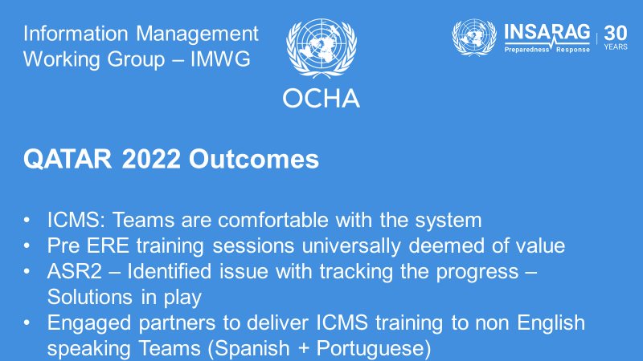

Slide 66


Slide 67
Q&A

Slide 68
SESSION 3: Technical Working Group Workplans 2022 – PART 2
Light Team Quality Assurance Reference Group
Brad Commens
6. Medical Working Group
Anthony Macintyre
7. National Accreditation Working Group
Sebastian Mocarquer and Cheng Hong
8. Training Working Group
Dewey Perks
3
Notes:
Letter 2 of 3 From Emily to WG co-chairs/Chairs

Slide 69
5. Light Team Quality Assurance Reference Group

Slide 70
SESSION 3: WG Workplans 2022 –
Light Team Quality Assurance Reference Group
Progress Update - Brad Commens Co-Chair
LTQARG Members:
Brad Commens (AUS), Rob Davis (GBR), Christophe Debray (FRA), Johannes Gust (GER), Cem Behar (TUR).
History
2016 - LTWG was established to investigate the opportunity for Light USAR teams to be Classified under the same guidelines as Heavy and Medium teams.
2017 - Concept paper, Quality Assurance, Team Development Framework, and linkages to National (NAP) and International (IEC) principles presented to Regional meetings, TL meetings and ISG. Transitioned to LTQAWG.
2018 – Position Paper and Light IEC Teams Integration concept presented at regional meetings. Light USAR IEC Checklist developed and consulted with Team Leaders, and approved by TL’s in Bucharest.
2019 – Light USAR IEC format and checklist approved by ISG. First Light USAR Team IEC planned for 2019, delayed due to country approvals.
2019 – Programmed the first Light USAR IEC for June 2020 - @fire German NGO. Delayed due to COVID pandemic.

Slide 71
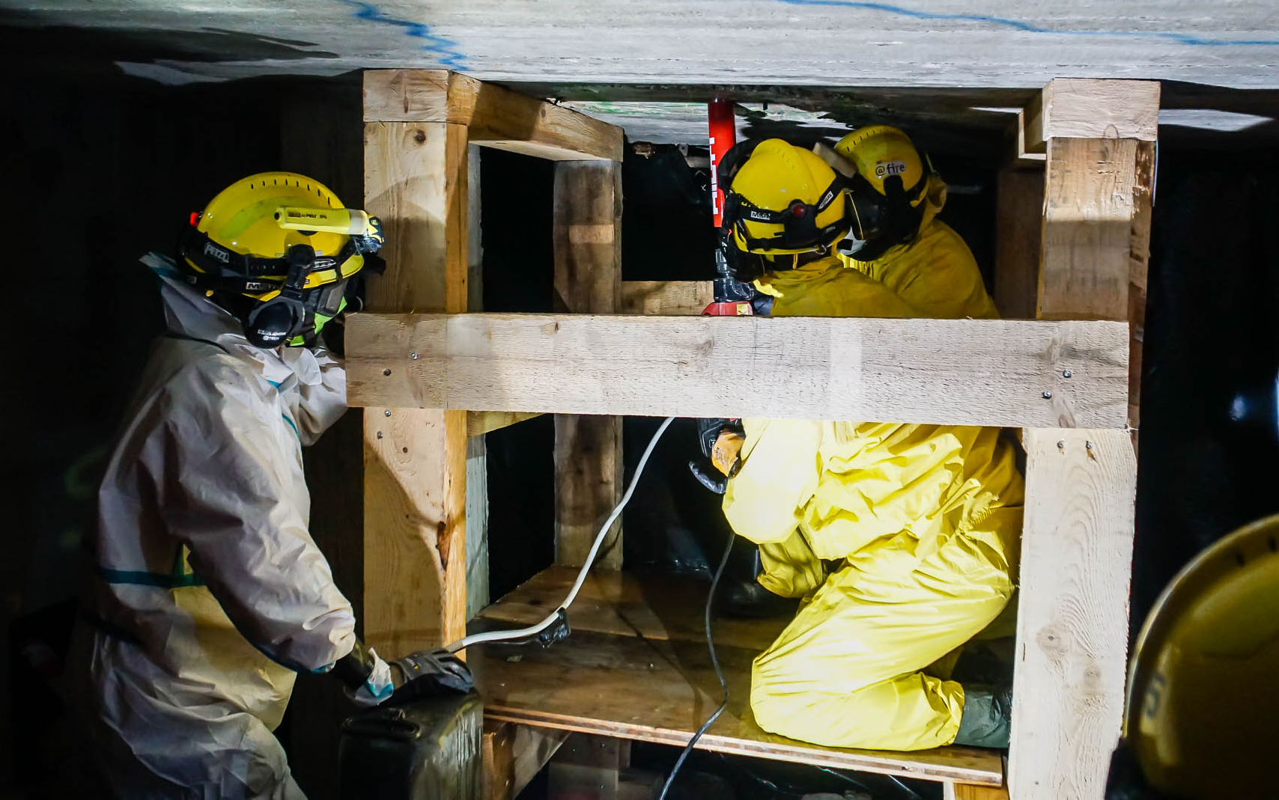
Light Team Quality Assurance Reference Group
LTQARG Update – Brad Commens Co-Chair
Outcomes
2021 – First Light USAR IEC completed at INSIEME 2021 from 21-24 November
Review of @fire IEC conducted on 20 December 2021 by LTQAWG
2022 - Report on the review of the @fire IEC provided to INSARAG Secretariat on 28 January 2022.
LTQAWG meetings 7 & 8 March 2022. Group transition to LTQARG (Reference Group) approved at the TL Meeting in Qatar. Reference group members are available to assist evolving Light teams and to provide guidance and clarification top to IEC Classifiers, Mentors and teams.
Planned future activities
August 2022 – Light USAR IEC – GEA - Turkey
September 2022 - Light USAR IEC – SARAID – United Kingdom
December 2022 – Light USAR IEC – Cyprus
@fire IEC

Slide 72

Medical Working Group update
EVENT TITLE GOES HERE
Anthony Macintyre, MD
10th May 2022

Slide 73
MWG Participants
Membership:
Australia – Hector Fuentes
Chile – Vincenzo Borgna
China – Peng Bibo
Japan – Yasushi Nakajima
Netherlands – Thomas Eckhardt
UK ISAR – Malcolm Russell
UK SARAID – Will Selley
USA – Anthony Macintyre (Chair)
WHO – Rudi Coninx - Goodbye!
WHO – Kevin Ousman – Hello!
Technical Expert – Trevor Glass (Co-Chair)

Slide 74

INSARAG and WHO EMT
Joint Statement
Key Points:
At the time of mobilization, teams should research and ensure adherence to the entry requirements of disaster impacted countries they are deploying to assist.
All field response personnel considered for potential international response are encouraged to obtain COVID-19 vaccination as soon as it becomes available to them through the prioritization schemes in their host country and/or sponsoring organization. As per standard procedures, all vaccination records should be available for presentation when requested.
Teams must ensure that protocols to manage possible exposure are in place and all team members have trained on these prior to deployment.

Slide 75
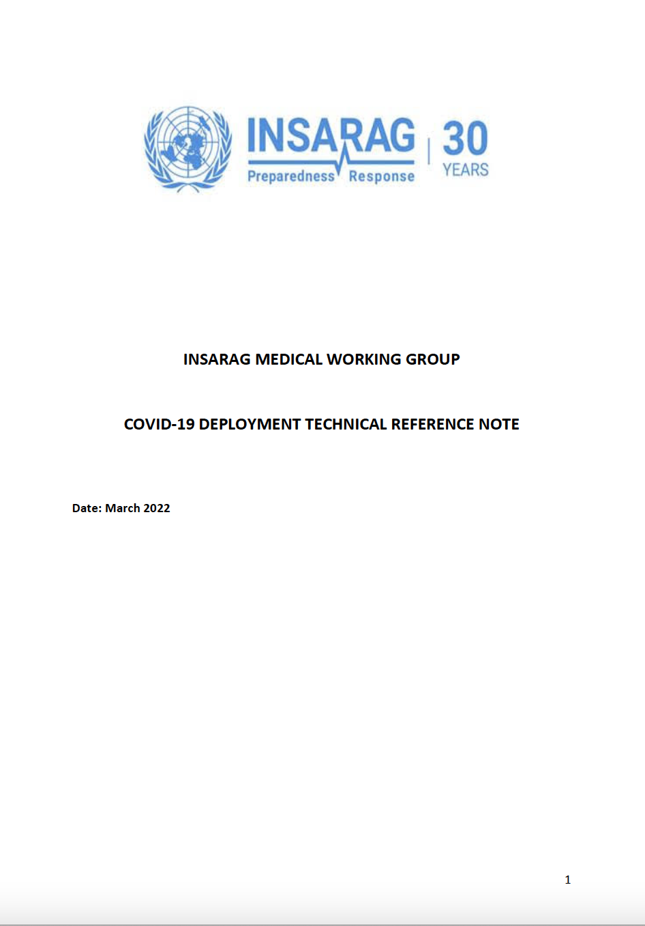
Covid-19 Deployment Technical Reference Note
Updated – March 2022
COVID-19 Deployment Technical Reference Note
  Document is intended to provide updated information to USAR teams seeking to enhance their field operations in the SARS CoV2 virus (COVID-19) environment.
  In order to remain mission-ready, teams need to strike the balance, in a rapidly evolving environment, that enables them to achieve the two primary goals of:
    Protecting their workforce
    Maintaining operational capability and respond as required

Slide 76
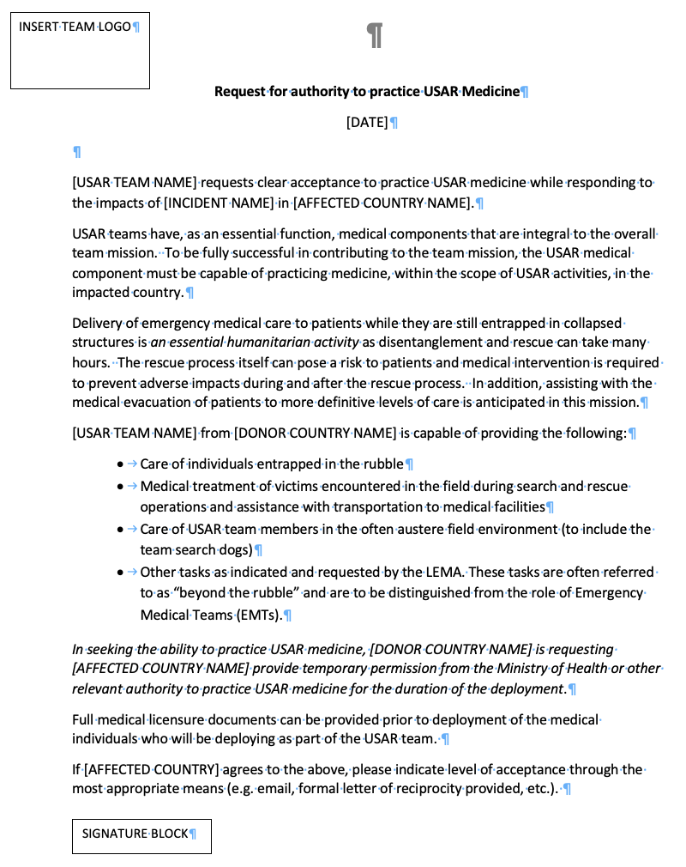
Permission to Practice
Request for authority to practice USAR Medicine
Right to clinical practice cannot be assumed
USAR Teams should seek temporary permission to provide clinical care
Aligns with WHO EMT requirements
Delivery of emergency medical care to patients while they are still entrapped in collapsed structures is an essential humanitarian activity
MWG has produced a Generic Letter to assist teams

Slide 77

MWG Workplan
Current and ongoing
Monitoring of Covid-19 scientific evidence and potential for additional guidance - Ongoing
  Covid-19 landscape continues to evolve (new variant emergence) and pose new challenges
  Potential for new risk mitigation measures
  How to co-exist with the virus
Collaboration with WHO EMT Strategic Group - Ongoing
  MWG contributing to the drafting of the pre-hospital section of the EMT Spinal Cord Injury Guidelines
  Operational coordination in the field
Flexible WG assistance – Ongoing
Review of select Technical Reference notes – Ongoing
IEC/IER guidance and GRG (2023!) - Ongoing

Slide 78
MWG Support to TL
How can we help you?
Are there any medical challenges you facing that the MWG can assist with?
  Send any requests/queries to insarag@un.org
MWG Next Meeting
Tentative: November 2022

Slide 79
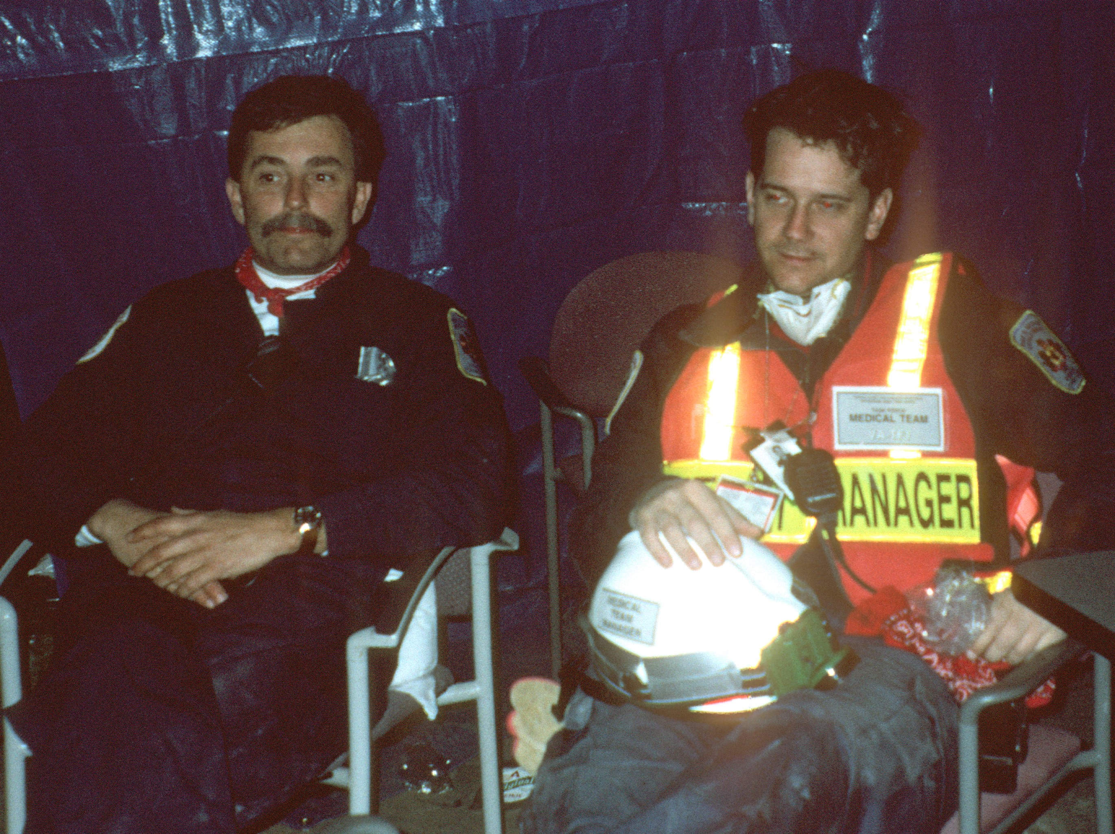
Question to the INSARAG Community
How do we continue to recruit?

Slide 80
Medical Working Group (MWG)
USAR Team Leaders Update – 2022
Membership:
Australia – Hector Fuentes
Chile – Vincenzo Borgna
China – Peng Bibo
France – Magali Jeanteur
Japan – Yasushi Nakajima
Netherlands – Thomas Eckhardt
UK ISAR – Malcolm Russell
UK SARAID – Will Selley
USA – Anthony Macintyre (Chair)
WHO – Rudi Connix
Technical Expert – Trevor Glass

Slide 81
INSARAG and WHO EMT
Joint Statement
Key Points:
At the time of mobilization, teams should research and ensure adherence to the entry requirements of disaster impacted countries they are deploying to assist.
All field response personnel considered for potential international response are encouraged to obtain COVID-19 vaccination as soon as it becomes available to them through the prioritization schemes in their host country and/or sponsoring organization. As per standard procedures, all vaccination records should be available for presentation when requested.
Teams must ensure that protocols to manage possible exposure are in place and all team members have trained on these prior to deployment.

Slide 82
Permission to Practice
Request for authority to practice USAR Medicine
Right to clinical practice cannot be assumed
USAR Teams should seek temporary permission to provide clinical care
Aligns with WHO EMT requirements
Delivery of emergency medical care to patients while they are still entrapped in collapsed structures is an essential humanitarian activity
MWG has produced a Generic Letter to assist teams

Slide 83
Covid-19 Deployment Technical Reference Note
Updated – March 2022
COVID-19 Deployment Technical Reference Note
  Document is intended to provide updated information to USAR teams seeking to enhance their field operations in the SARS CoV2 virus (COVID-19) environment.
  In order to remain mission-ready, teams need to strike the balance, in a rapidly evolving environment, that enables them to achieve the two primary goals of:
    Protecting their workforce
    Maintaining operational capability and respond as required

Slide 84
MWG Workplan
Current & Ongoing
Monitoring of Covid-19 scientific evidence - Ongoing
  Covid-19 landscape continues to evolve (new variant emergence) and pose new challenges
  MWG members are directly engaged in prevention of transmission and clinical management Covid-19
  Emerging scientific evidence will be incorporated into MWG technical reference notes as required
Review of potential additional Covid-19 risk mitigation measures - Current
  In addition to the established risk mitigation measures, e.g., physical distancing, hand hygiene, wearing of masks, regular health checks, explore additional measures that could potentially be employed to increase surveillance, e.g.:
    Rapid Antigen Testing (RAT)
EMT Spinal Cord Injury Guidelines - Current
  MWG contributing to the drafting of the pre-hospital section of the EMT Spinal Cord Injury Guidelines
https://www.who.int/news/item/28-11-2021-update-on-omicron

Slide 85
MWG Support to TL
How can we help you?
Are there any medical challenges you facing that the MWG can assist with?
  Send any requests/queries to insarag@un.org
MWG Next Meeting
HPNW 2022
MWG plan to meet in-person during the HNPW in Geneva in May 2022

Slide 86
7. National Accreditation WG

Slide 87
National Accreditation Working Group (NAWG)
Introduction
Main purpose of the NAWG:
    Support the implementation of the IRNAP concept
    Provide guidance to regional groups and member states
    Promoting the exchange of experiences
Established in August 2020, after ISG endorsement.
    Composed by representatives from 15 member states across the three regions.
Initial term of 2 years.
Member states with intention of going through the IRNAP in the next years
Source: NAWG global survey (2020)

Slide 88
National Accreditation Working Group (NAWG)
Progress update
01
02
03
04
IRNAP
Guidance Note
Updated guidance note proposed for endorsement
Consultation process
IRNAP Checklist and related documents
  Updated IRNAP checklist proposed for endorsement
  Other related documents pending
IRNAP
Training
  Virtual training developed by NAWG (8 hours)
  TSG/TRG roster training developed by the Americas (5 days)
Remote Support to Regions
  Support to Americas and Asia Pacific regions on methodological issues and standards interpretation

Slide 89
National Accreditation Working Group (NAWG)
Way forward
Training
Guidelines review
Regional support
    Review training course for TSG/TRG, developed by the Americas, and facilitate global delivery
    Adapt Virtual IRNAP training into an 4-hour workshop aimed at policy makers, national authorities and future TSG/TRG
    Update IRNAP Guidance Note in light of experience and application of the methodology globally
    Contribute to the update and streamlining of Manual A: Capacity Building
    Review and develop supporting documentation
    Continue support to regions on methodological issues and interpretation on guidelines
    Monitor IRNAP implementation globally for coherence
An extension of the NAWG term for an additional two years to continue the support of the global implementation of the IRNAP is kindly requested for endorsement.

Slide 90
8. Training WG

Slide 91
SESSION 3: WG Workplans 2022 – Training WG
Many Thanks to the Sponsors
Training WG – Progress Update
Core Members:
Kira Chebakova – RUS
Jacob Bolwinkel – DEN
Peter Goxharaj – GER
Tsukas Katsube – JPN
Joshua “JT” Turner – AUS
Dewey Perks – USA
Lucien Jaggi – ERS Secretariat
Associate Experts:
Arjan Stam – Form TL Rep
Paul Burns – TL Rep
Robert Norman – IMWG
Trevor Glass – MWG
John Denny – IEC/R Secretariat Rep
John Cawcutt – IEC/R Secretariat Rep

Slide 92
TWG REPORT - Updates of 2020 f
Progress
  Monthly Virtual Meetings
  WG Cross Pollination
  Participation on other WGs
Challenges –
  Time Management
  Lack of Travel
Current Workload:
UC Training
UC Manual Revision
IEC-IER Exercise Design Handbook
ERE Review
Leadership Training
EU - INSARAG Relationship
Classifier Review Project
Web-Based Training
National Coordination Training
1st Responder Course Review

Slide 93
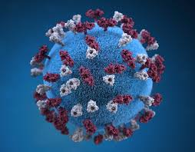
Key Focus for 2022 - 2023
UC Manual Revision
UC Training Revision
IEC-IER Exercise Design Handbook
ERE Review
Leadership Training
Web-Based Training
National Coordination Training
1st Responder Course Review

Slide 94


Slide 95
Q&A

Slide 96

LUNCH BREAK
Meeting will resume at 14:00

Slide 97
2
Issues for ISG’s Decisions and Endorsement
PART 2

Slide 98
SESSION 4: INSARAG Steering Group Decisions on Key Items
4
Notes:
Letter 3 of 3 to the five leads, to chase for Each person how many minutes.
Each of them 2-3 pages
- Check with Marie is the paper ready?
Progress Update:
Flexible Response Global Position (FRWG) – Progress Update
Improvements of the Guidelines on Bilateral Response (T-GRG Lead)
Endorsement:
National Accreditation Process V2.0 (NAWG Lead) – Progress Update
First Responders Program V2.0 (TWG Lead)
UC Manual V2.0 (TWG Lead)

Slide 99
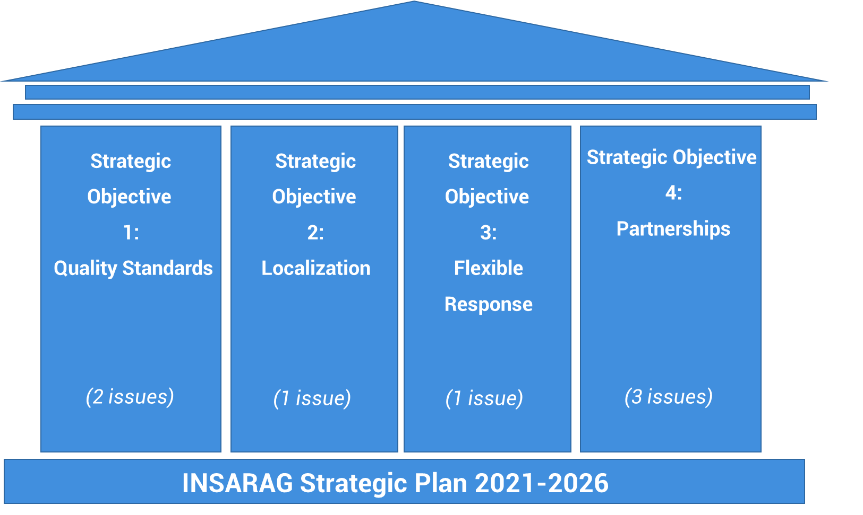
SESSION 4: INSARAG Steering Group Decisions on Key Items
Progress Update
Endorsement
Improvements of the Guidelines on Bilateral Response
First Responders Program 2.0
National Accreditation Process 2.0
Flexible Response Global Position
UC Manual 2.0

Slide 100
SESSION 4: INSARAG Steering Group Decisions on Key Items – Flexible Response Global Position
Progress Update
Mr. Paul Baxter
Mr. Paolo Vaccari
Co-Chairs, Flexible Response Working Group
Notes:
Add water USAR – flexible water rescue mission

Slide 101
SESSION 4: INSARAG Steering Group Decisions on Key Items – Improvements of the Guidelines on Bilateral Response
Progress Update
Mr. Martin Evers and David Lewis
T-GRG Lead

Slide 102
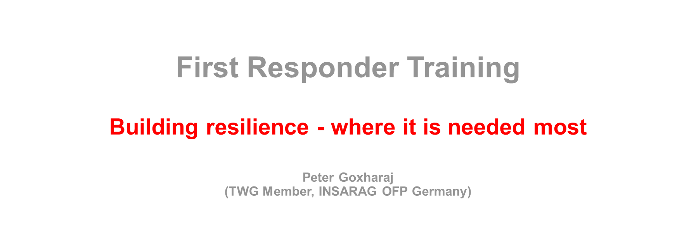
SESSION 4: INSARAG Steering Group Decisions on Key Items – First Responders Program V2.0
Progress Update
Mr. Peter Goxharaj
TWG Member, Operational Focal Point Germany

Slide 103
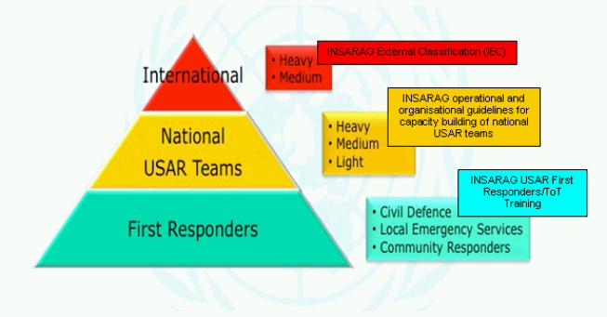
SESSION 4
As local as possible – resilience building!
Grass Root Level…. The new approach, more local is hardly possible! We have to consider that the intl. USAR teams deploy rarely, but also only for bigger quakes…. What about those hundreds of local “small” quakes?
Building local resilience will save much more lives in the future…
It is proven fact that local First Responders save more lives than intl. USAR teams. Enhancing the performance of the Community Responders is important as in many countries the amount of professional First Responders is limited. Additionally, many villages and small cities are in remote areas and difficult to reach…

Slide 104
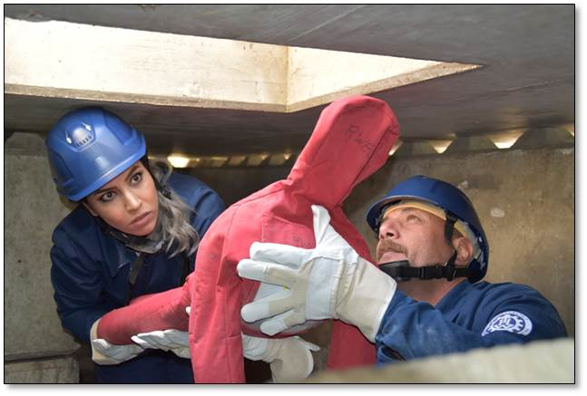
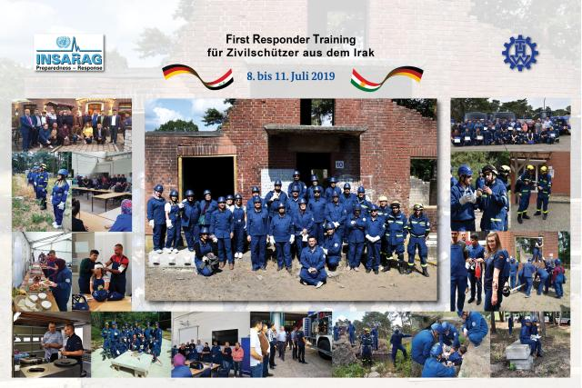
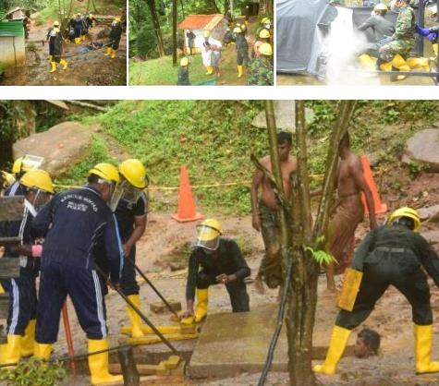
SESSION 4
For the first time ever “as local as possible”
The FRT 2.0 will reach grass root level world wide. Customized for citizens, villagers, persons who never thought that they can be relief…
The new training course is designed to enable the participants to do basic but effective search and rescue work with local tools within 3.5 days!

Slide 105
SESSION 4
The final time schedule for implementation:
Pre-endorsement by ISG May 22
Presenting the final version at RG meetings
Endorsement by ISG at HPW
Field test
Georgia
June 22
September 22
Winter 22
MAY 2023
August 22
Field test
In Asia
Autumn 22
Final review by TWG
Field test
Iraq

Slide 106
SESSION 4: INSARAG Steering Group Decisions on Key Items – National Accreditation Process V2.0
Endorsement
Mr. Sebastian Mocarquer
National Accreditation WG Co-Chair

Slide 107
IRNAP Guidance Note v2.0
Introduction

Slide 108
IRNAP Guidance Note v2.0
Member states with an INSARAG recognized NAP
Member states that plan to go through an IRNAP in 2022:
Chile, Cyprus, Panama, Singapore, Argentina, Ecuador and Honduras.

Slide 109
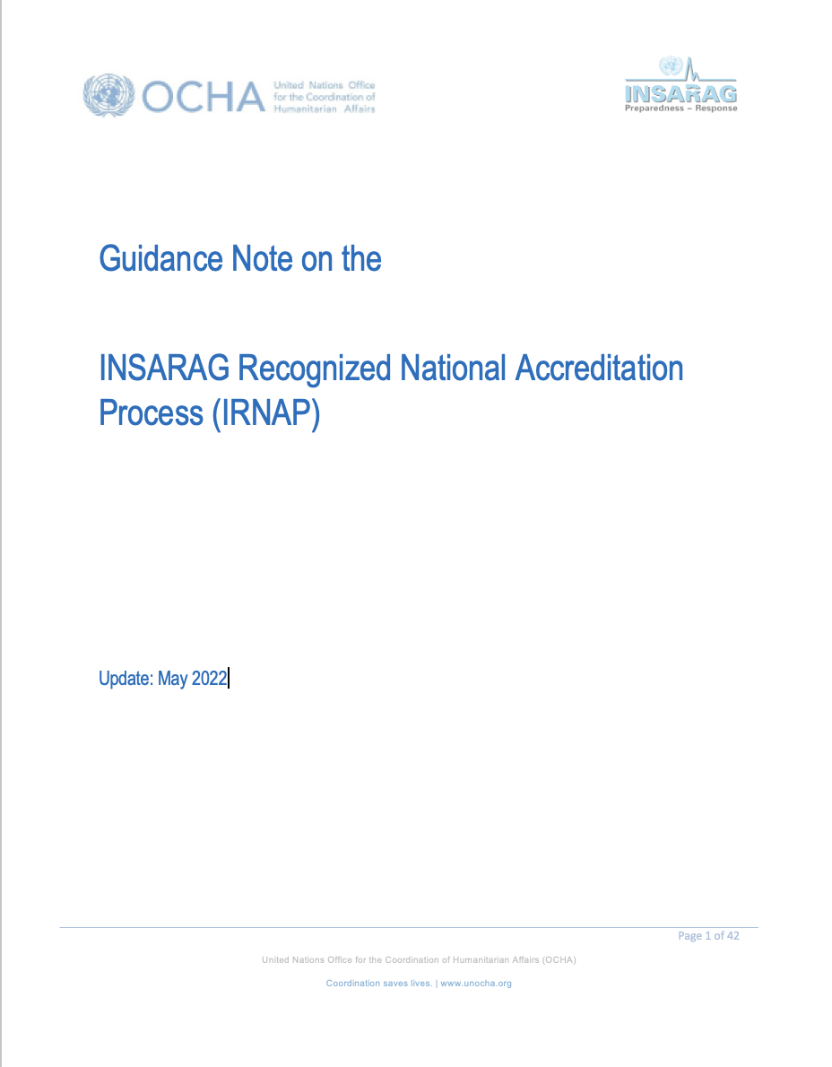
IRNAP Guidance Note v2.0
Main updates to Guidance Note
Guidance added to the NAP and IRNAP description
Updated TOR for TSG/TRG roster
Updated training requirements for members of TSG/TRG roster
Funding: TSG to be funded by requesting country/TRG to be funded by member states in the network that provide experts (including their training)
Expanded explanation of adoption of INSARAG methodology at a national level
Clarification of commitment and verification criteria’s
Updated all figures across the document and format update

Slide 110
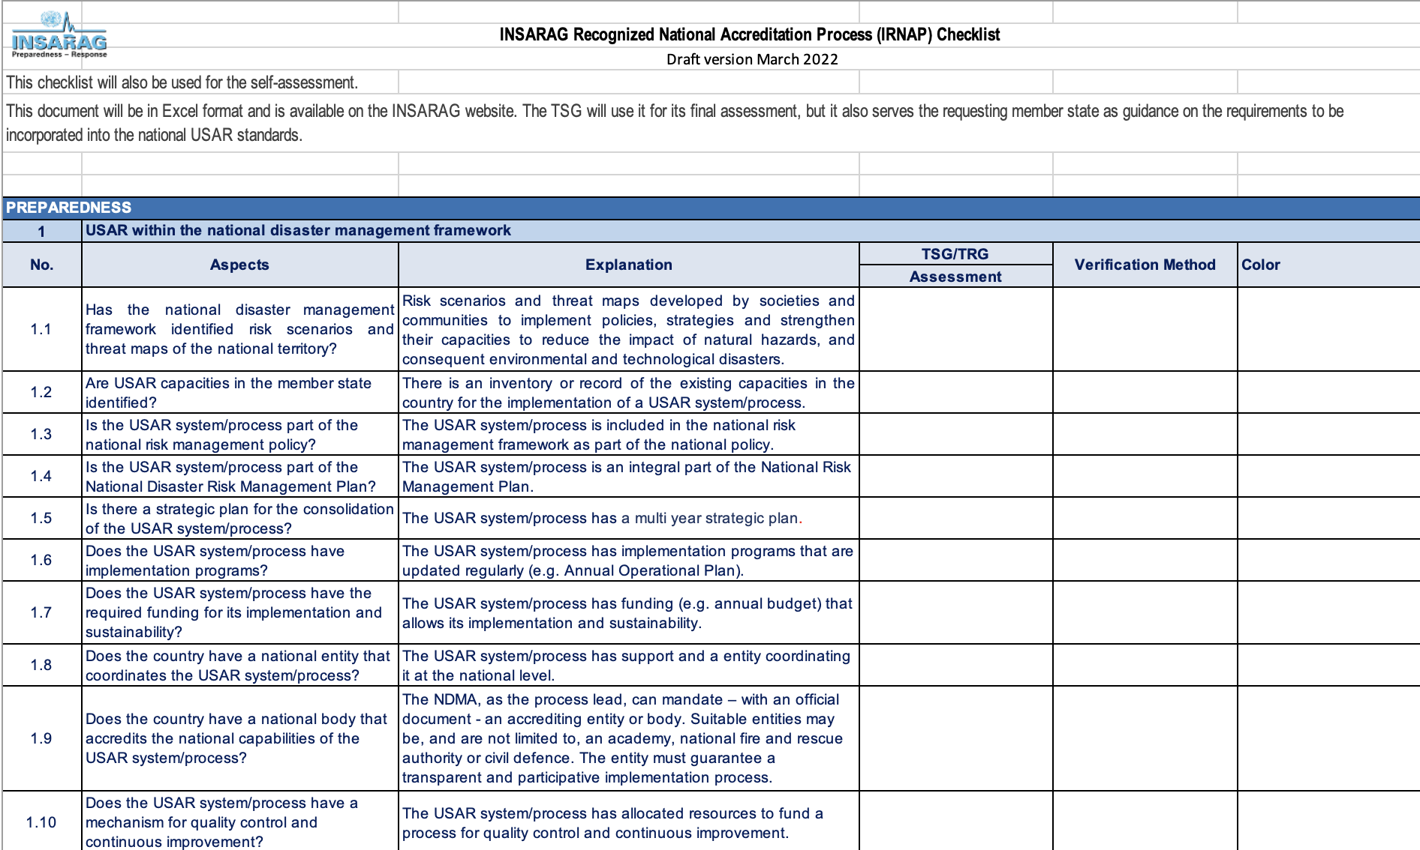
IRNAP Guidance Note v2.0
Main changes to Checklist
Section 1 was updated to allow a global application of the checklist by accounting for diversity of political, legal and administrative structures within member states.
Updated 2019 IRNAP Checklist to reflect minimum standards for USAR operations according to IEC/R Checklist 2020.

Slide 111
IRNAP Guidance Note v2.0
Extensive Consultation Process
IRNAP Session at the 2022 Team Leaders Meeting (Qatar).
Distribution of first draft for network consultation on March 15th.
    IRNAP Technical Guidance Note v2.0
    IRNAP Checklist v2.0
    Change record for reference
Three virtual workshops to gather feedback:
    Regional Workshop AEME, April 4th
    Regional Workshop Americas, April 5th
    Regional Workshop AP, April 6th
Final draft for for network consultation distributed on April 20th.
Overwhelming support to the IRNAP Guidance Note update
The NAWG appreciates and thanks all who actively engaged with feedback

Slide 112
IRNAP Guidance Note v2.0
Future work
As more members states go through the IRNAP process, the need to update the Guidance Note can be anticipated
Areas already identified for future work:
    Planning guidance for the support and recognition stages
    Develop guidance to identify the baseline status of member states (design, advanced and consolidated levels)
    Guidance for TSG/TRG composition, including profile for member selection
    Add guidance for specific roles and responsibilities for TSG/TRG members in the form of a checklist
    Add flowchart of the IRNAP process to provide a general overview of the process

Slide 113
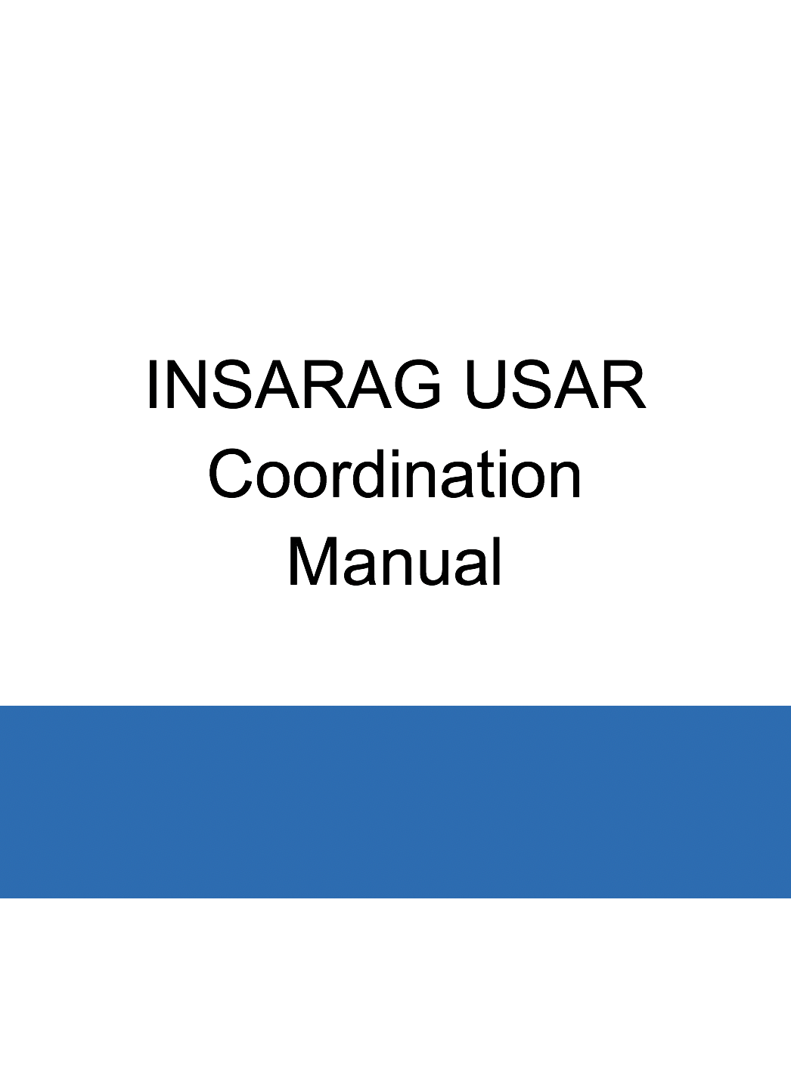
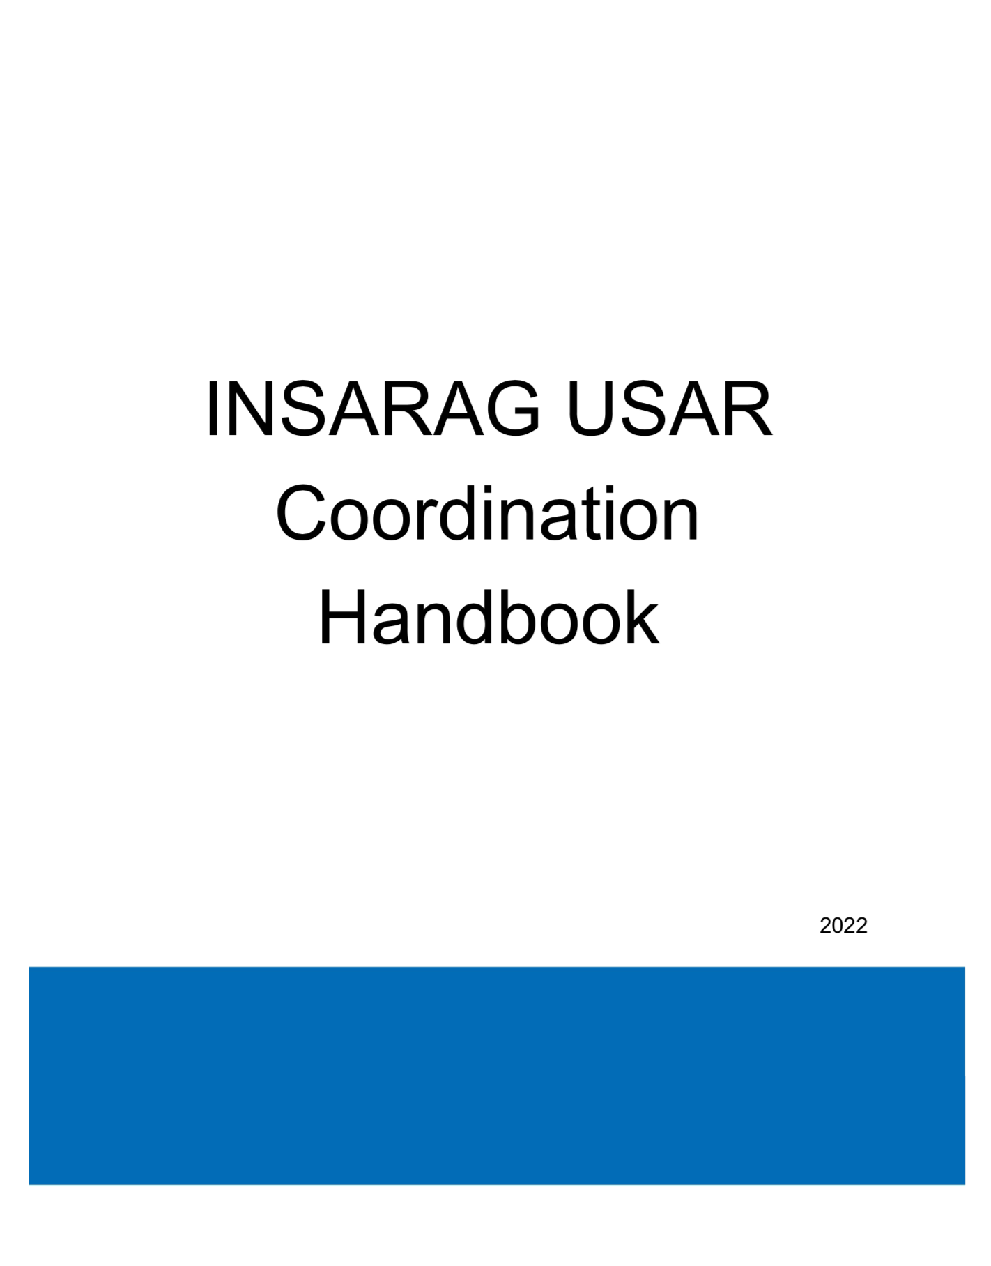
SESSION 4: INSARAG Steering Group Decisions on Key Items – UC Manual V2.0
Endorsement
USAR Coordination Manual Revision
Sub-Working Group composition:
Training Working Group
Information Management Working Group
UNDAC members
Aims:
To update the UC Handbook in line with the ICMS
To review the UC Handbook
To remove discrepancies between UC Manual, INSARAG Guidelines 2020, UNDAC and EMT documents

Slide 114
SESSION 4: INSARAG Steering Group Decisions on Key Items – UC Manual V2.0
Endorsement
UC Handbook Draft Revisions
Draft # | When | Revision by whom
Draft 1.0 | 15 Jul – 15 Aug 2021 | INSARAG Working Groups
Draft 2.0 | 15 Sep – 15 Oct 2021 | INSARAG USAR Teams & Secretariat
Draft 3.0 | 4 Feb 2022 | INSARAG Community
Draft 4.0 | TL Meeting March 2022 | Participants (in-place and remote)

Slide 115
SESSION 4: INSARAG Steering Group Decisions on Key Items – UC Manual V2.0
Endorsement
No changes to the methodology
Structure of the document changed to
  include updated information
  improve the flow of the content.
UC Handbook Annexes are part of the document
  Not links to www.insarag.org.
  New Annexes to help information collection, planning and coordination.
Forms in www.insarag.org revised/converted to EXCEL and PDF format
  3 forms changed
  2 new forms made
  No changes to forms used for ICMS
  No JPG files
Information Displays in www.insarag.org revised/converted into Word docs.
  No JPG files
Notes:
No changes to the methodology, we still have our same old system
Structure of the document was changed to
include updated information
improve the flow of content.
UC Handbook Annexes are part of the document –
Not links to www.insarag.org.
Forms in www.insarag.org have been converted to EXCEL and PDF format – so it is possible to edit
Not JPG
No changes to forms used for ICMS
Information Displays in www.insarag.org updated/converted into Word docs. – so it is possible to edit
Not JPG
The most common comments by far was on the RDC and how it is part of a bigger system.
When we discuss RDC from our perspective, things are clear. The issues come up when we talk about responsibilities of others and of us towards them. The approach in the Handbook is to teach USAR teams to manage a good RDC for USAR teams and to also be helpful to others who are also involved in RDC work. EMTs, for example deploy more often that USAR teams, so they do not rely on USAR teams, but when we can work together we should.

Slide 116
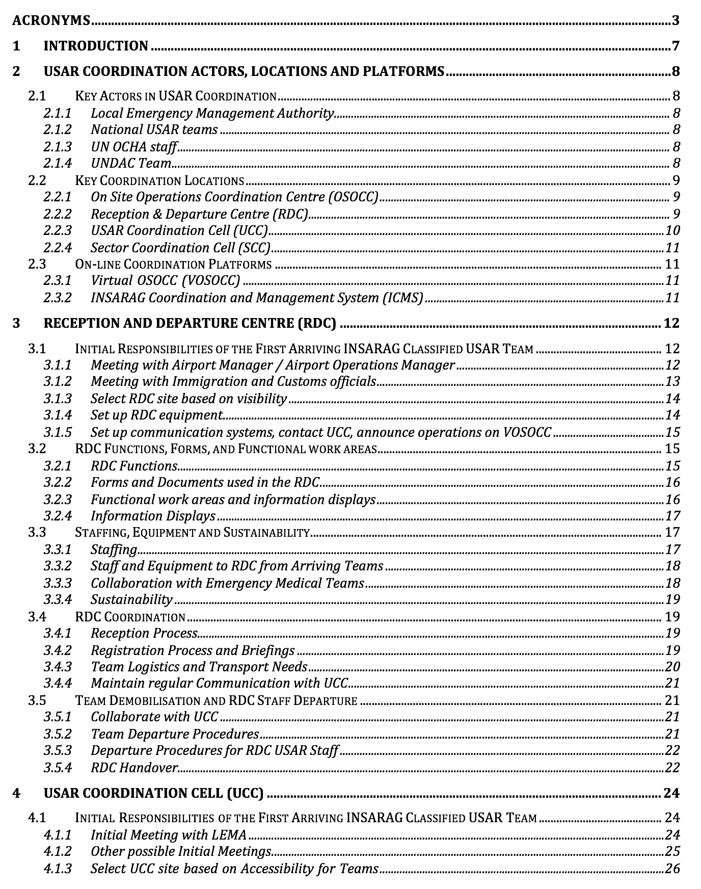
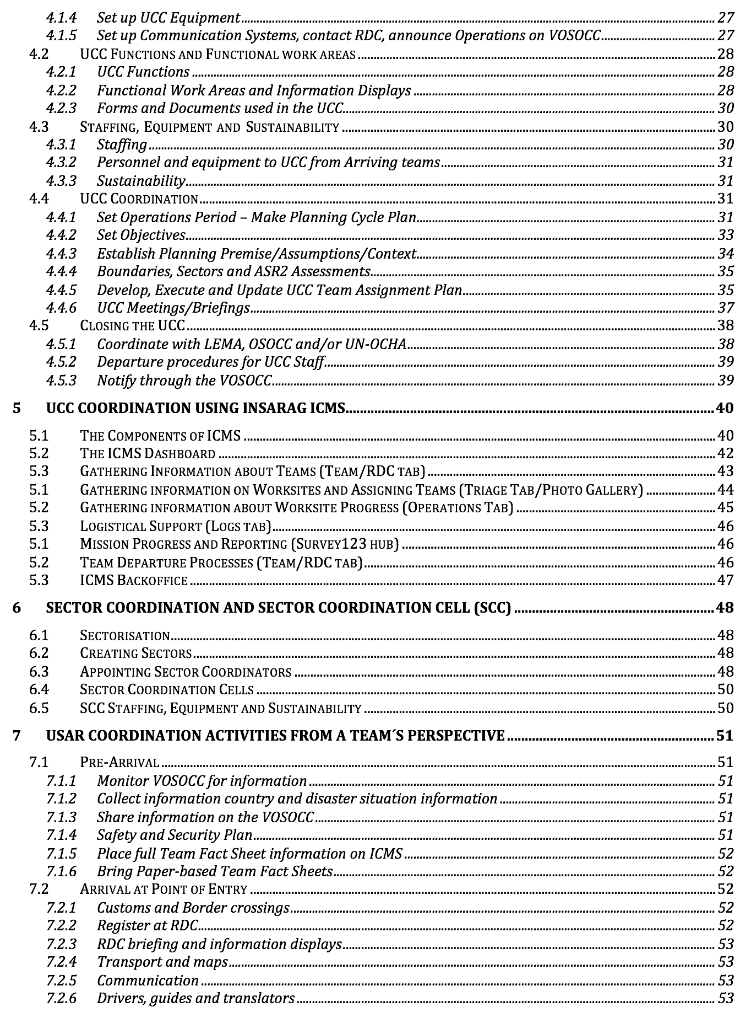
Notes:
Section 1 is an introduction
Section 2 highlights the key coordination actors, coordination cells and online platforms, to make the reader understand what this Handbook is addressing.
Section 3 and 4 are on RDC and UCC.
The structures of the RDC and UCC sections are identical at the sub-section level (2.1, 2.2. etc)
tasks of the first arriving teams,
Functions, forms and work-spaces
Staffing and equipment of the cells,
the coordination processes in each cell
Finally demobilization processes.
Section 5 is a new section on using ICMS as a coordination tool.
Section 6 is about sector coordination.
This is not set up the same as for UCC, as it would just have been a repeat of that section, but we tried to highlight is new and different.
Sector 7 is a new section that outlines the role of the teams as part of the entire coordination process.
Based on our comments, this is a very popular section in the Handbook. It will propably develop as we start using it.

Slide 117
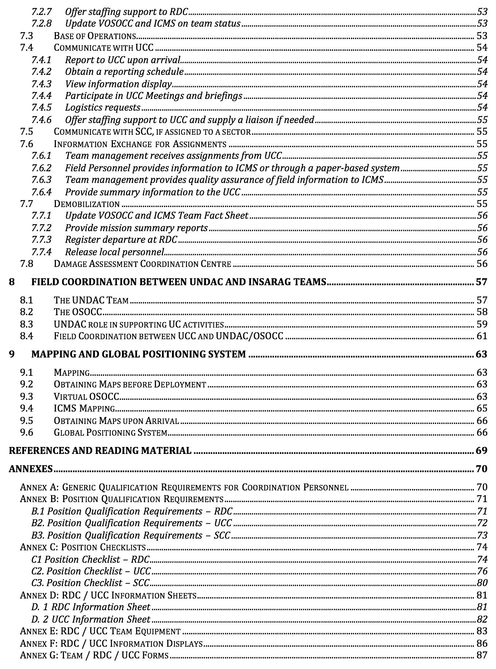
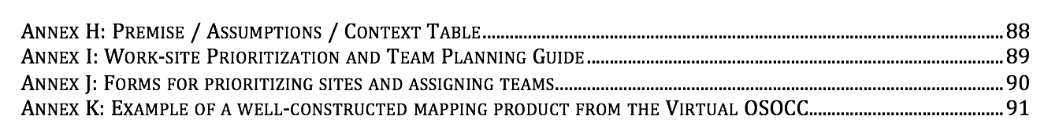
Notes:
Section 8 addresses of the role of UNDAC
It is intentional to have UNDAC in the title and not the OSOCC
The UNDAC team runs OSOOCC, so we include the OSOCC
But an UNDAC person may be in the UCC so the link to the OSOCC may be through the UNDAC in the UCC
Keep in mind that an OSOCC may not necessarily be set up even though there are UNDAC people, (ex, Albania)
Also, if the UCC manager has problems, UNDAC people are trained to be supportive regardless of the situation of an OSOCC.
Section 9 is the mapping section.
Some wanted it as an annex, but it doesn´t really make a difference whether it is a secion on an annex.
The References and Reading Material seems to have jumped to be under section 9 instead of beeing a separate section, we will fix that.
The Annex are lots of tables and guides for people so use.
There are 3 things we would like to hightlight regarding ICMS, Updated forms and new form:

Slide 118
SESSION 4: INSARAG Steering Group Decisions on Key Items – UC Manual V2.0
Endorsement
Updated Forms
in Volume III – Operational Field Guide
Annex B6 “RDC Briefing Handout Form” |  | UPDATED
Annex B9 “OSOCC Planning Guide” |  | “UCC Team Assignment Status”
Annex B11 “OSOCC-LEMA Initial Briefing” |  | “UCC-LEMA Meeting Form”

Slide 119
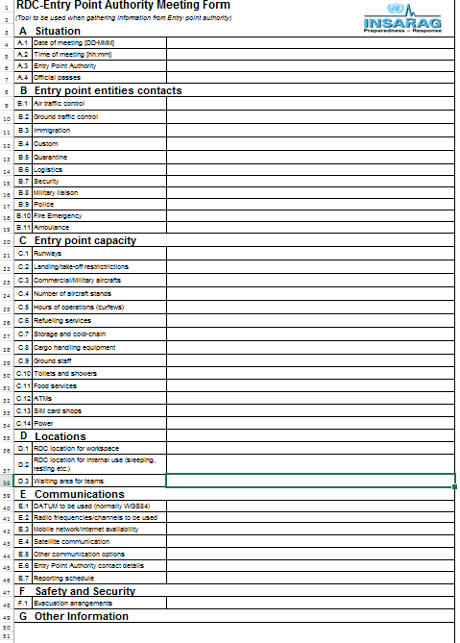
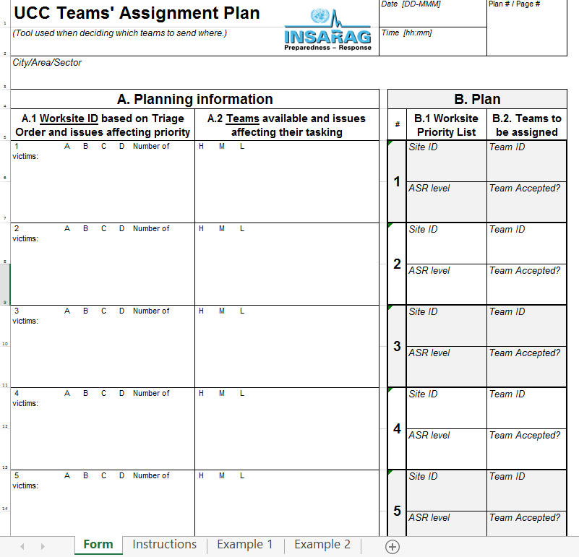
SESSION 4: INSARAG Steering Group Decisions on Key Items – UC Manual V2.0
Endorsement
New Forms
in Volume III – Operational Field Guide
RDC-Entry Point Authority Meeting Form
UCC Teams’ Assignment Plan
Notes:
It was noticed that there is only an “UCC-LEMA Meeting Form”, but there was not the same form for the initial RDC meeting with entry point authority. The corresponding form was made.
To facilitate planning process a new form “UCC Teams’ Assignment Plan” was made. Instructions on how to use it are included

Slide 120
SESSION 4: INSARAG Steering Group Decisions on Key Items – UC Manual V2.0
Endorsement
How ICMS was added
The Handbook is written so that you learn the coordination system regardless of tools – first learn what to do and then look at options on how.
You learn about the system (sections 2-4), then you can apply software (5)
ICMS in intentionally only addressed in one section so you don’t need to look all over the Handbook to find it.
Making updates on ICMS information is easy, only have to change section 5.
Notes:
There were some concerns on how ICMS was added into the handbook and issues regarding updates, as we know changes are coming.
This has been taken into consideration as follows
The Handbook is written so that you learn the coordination system regardless of tools – so you know what to do and have options on how.
Once you understand the system from sections 2-4 you can apply software
ICMS in intentionally only addressed in one section so you don’t need to look all over the Handbook to find it.
Making updates on ICMS easy, as you only have to change section 5.

Slide 121
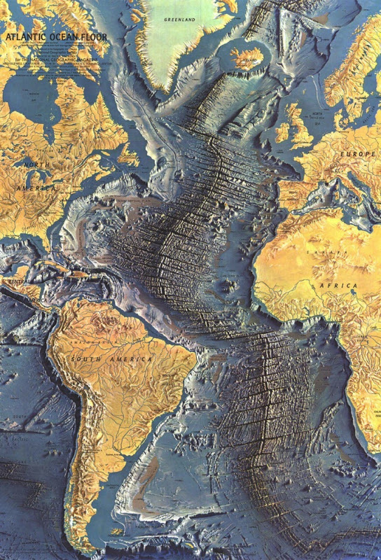
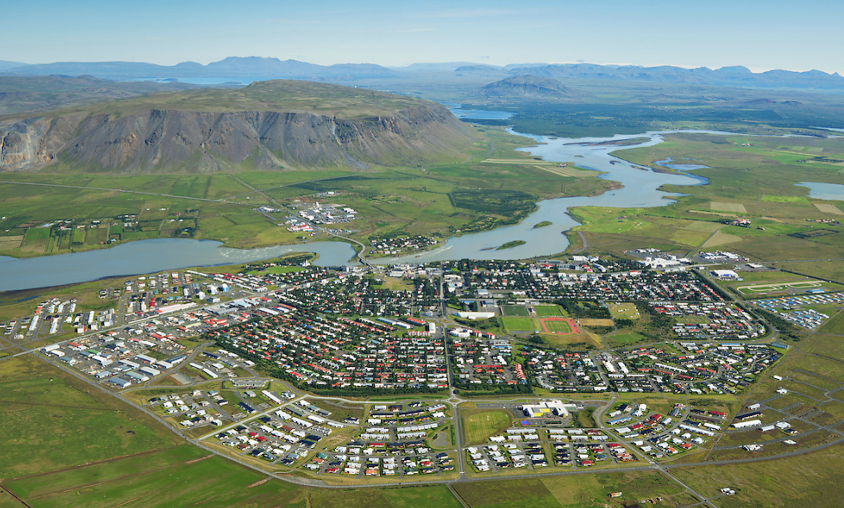
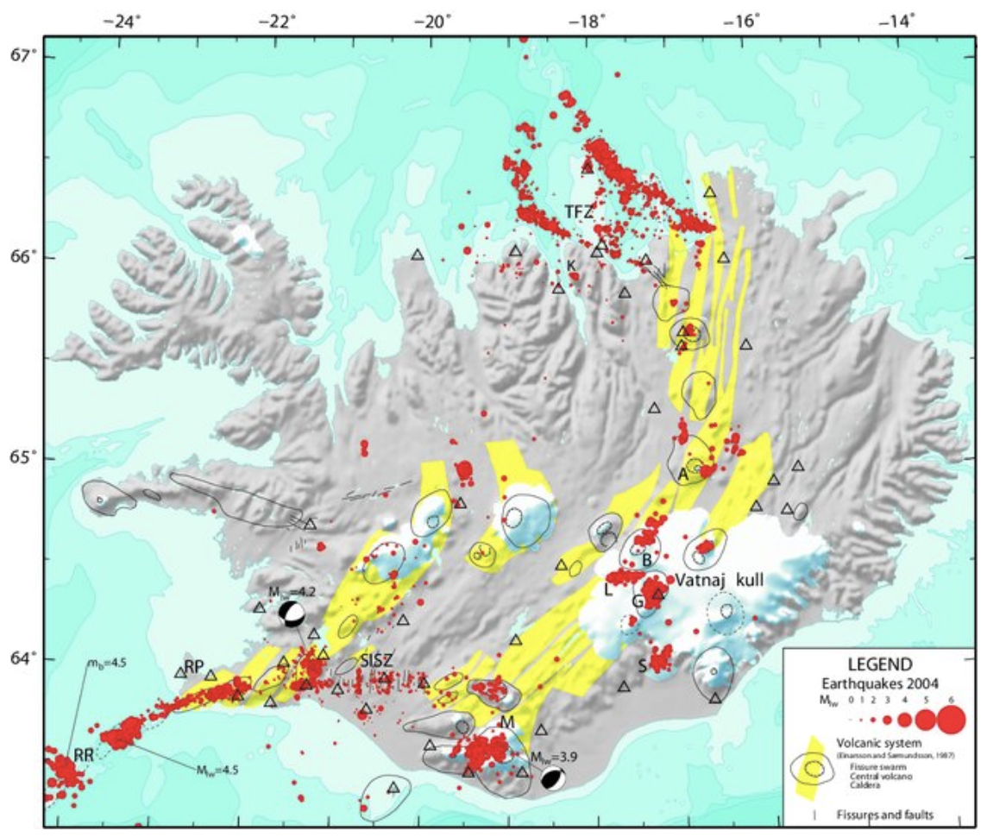
SESSION 4: INSARAG Steering Group Decisions on Key Items – UC Manual V2.0
Endorsement
Training-of-Trainers Course
For the AEME region
19th – 23rd September 2022
Iceland, town of Selfoss
Registration information sent out soon
Notes:
Next training
Red spots are earthquakes

Slide 122

SESSION 5: Summary of Key Decisions and Closing Statements
5

Slide 123

Draft Outcomes of the ISG 2022:
The ISG welcomes the HNPW 2022 Hybrid format and encourages in-person events where this is possible with a remote option, for participants, considering the host country's Covid-19 arrangements.
All 3 INSARAG Regional Workplans in 2022 are Endorsed.
The INSARAG Recognized National Accreditation Process (IRNAP) Technical Guidance Note is Endorsed.
The USAR Coordination (UC) Manual V2.0 is Endorsed.
The First Responders Program V2.0 process and its development for consultations at the Regional and WG meetings in 2022 is Endorsed.
Notes:
One more slides!
Number of participants, countries. Remote or ?
One more slide before the outcome !
Logo of TL Meeting and ambassador, meeting with Edem
Quick update, first meeting since 30 months
“Achieve more in three days than 30 months in remote”

Slide 124
Draft Outcomes of the ISG 2022:
All 8 Working Groups Workplans in 2022 are Endorsed and:
  The Light Team Quality Assurance WG will transition from a WG to a Reference Group, maintaining the same membership
  The ICMS will be supported until 2024 and incorporated into the UC Training.
  On Flexible Response: The Global Position sub WG will continue to consult widely with the network and at the Regional Meetings in 2022 and present their recommendations afterwards.
  The Transitional Guidelines Review Group will continue to consult widely with the network and at the Regional Meetings in 2022 and present a revised draft Guidance Note on Bilateral Response and propose plans for the next GRG to start in 2023-2025.
  The INSARAG Network will be consulted on a revised INSARAG External Reclassification (IER) system to tackle the exponential increase of IERs.
Notes:
One more slides!
Number of participants, countries. Remote or ?
One more slide before the outcome !
Logo of TL Meeting and ambassador, meeting with Edem
Quick update, first meeting since 30 months
“Achieve more in three days than 30 months in remote”

Slide 125
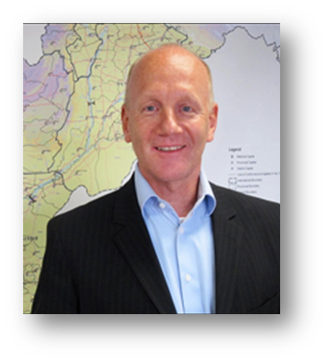
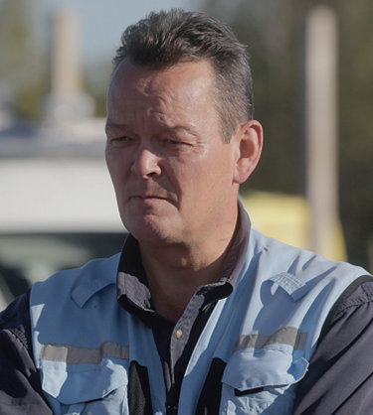
SESSION 5
Closing Statements
Sebastian Rhodes Stampa
Chief, Emergency Response Section, OCHA
INSARAG Secretary
Ambassador Manuel Bessler
INSARAG Global Chair
Notes:
Add Ana maria and All the RFPs’s potrait

Slide 126

THANK YOU!

